Slide 1
Government Affairs – Webinar
February 24, 2026

Slide 2
What You Need to Know – New Federal Tax Law

Slide 3


Government Affairs
What We Hope to Achieve Today
Develop a Better Understanding of the Working Families Tax Cuts Act
Individual Tax Provisions
Small Business Tax Provisions
Corporate Tax Provisions
State Decoupling
Introduce you to Rep. Blake Moore (UT)
Identify and Direct you to Resources & Materials

Slide 4


Government Affairs
WFTC Act is major federal tax legislation
Sets broad federal tax policy for the next decade
2017 federal tax law was set to expire Dec. 31, 2025
Extends 2017 provisions & enacts new tax policy

Slide 5
Government Affairs
Introduced in the U.S. House – May 2025
Final passage by Congress – July 3, 2025
Signed by the President – July 4, 2025
Effective Date January 1, 2026

Slide 6

Government Affairs
Congressman Blake Moore
Utah | 1st District
Elected to the U.S. House in 2020
Member – Ways & Means Committee
Member – House Budget Committee
Vice Chair – House GOP Conference

Slide 7
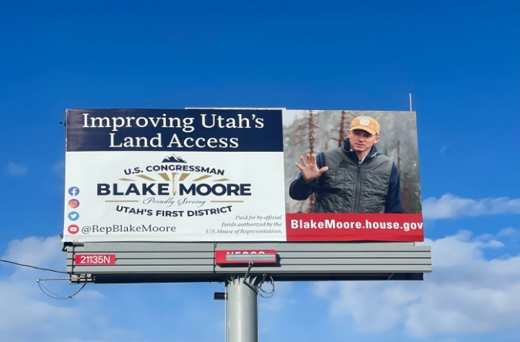
Government Affairs
Congressman Blake Moore | Utah – 1st District

Slide 8
Government Affairs
Federal Tax Rates – Permanent
Preserves the 2017 TJCA tax rates (effective through 12/31/25)
WFTCA preserves 7-tier tax structure
10% | 12% | 22% | 24% | 32% | 35% | 37%
If WFTCA were not enacted (pre-2017 rates)
10% | 15% | 25% | 28% | 33% | 35% | 39.6%

Slide 9
Government Affairs
Key Small Business Provisions
20% Small Business Deduction (QBI)
Permanently extends the Qualified Business Income deduction (Section 199A) for sole proprietors, LLCs, partnerships, and S corporations
100% Full Expensing
Allows for immediate deduction of the full cost of investment (permanent)
R&D Investment & Expensing
Allows for immediate deduction of R&D expenses, retroactive to 2022 (permanent)
1099-K Reporting
Increases the reporting threshold for 1099-NEC & 1099-MISC from $600 to $2,000
Reinstates (pre-2021) reporting for third-party organizations (200 transactions & $20,000)

Slide 10
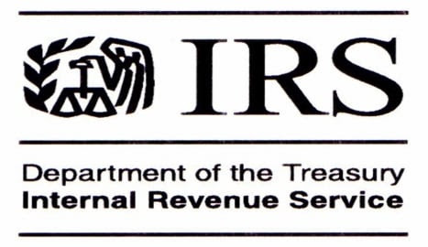
Government Affairs
Internal Revenue Code | State – Federal
States May Adopt the Internal Revenue Code (IRC)
1. As It’s Amended (Rolling Conformity)
2. As It Existed on a Specific Date (Static/Fixed-Date Conformity); or
Selectively Decouple from Specific IRC Provisions.
Rolling Conformity States – AK, AL, CO, CT, DC, DE, IA, IL, KS, LA, MA, MI, MS, MO, MT, ND, NE, NJ, NM, NY, OK, OR, PA, TN, RI & UT
Static/Fixed-Date Conformity States – AR, AZ, CA, FL, GA, HI, ID, IN, KY, MD, ME, NC, NH, SC, VA, VT, WI & WV
No Corporate Income Tax States – NV, OH, SD, TX, WA & WY

Slide 11
Government Affairs
Internal Revenue Code | State – Federal
States are severing state tax code connections to federal changes
§ 163(j) Return to EBITDA-Based Interest Limitation
Decoupled States – CT, GA, IA, IN, KS, MI, MO, MS, SC, TN & WI
§ 168(k) Permanent 100% Bonus Depreciation
Decoupled States – AR, AZ, CA, CT, DC, FL, GA, HI, ID, IL, IN, KY, LA, MA, MD, ME, MI, MN, NC, NH, NJ, NY, PA, RI, SC, VT & WI
§ 168(n) Full Deduction for Qualified Production Property / Certain Structures
Decoupled States – CA, FL, GA, HI, IL, KY, MD, MI & RI

Slide 12
Government Affairs
Internal Revenue Code | State – Federal
States are severing state tax code connections to federal changes
§ 174A Domestic Research and Experimental Expenditures
Decoupled States – AL, GA, IN, LA, MD, MI, MS, NJ, RI, TN & WI
No Tax on Tips & Overtime
Decoupled States – CA, CO, DC, IL, MA, MD, ME, NJ, & NY
State and Local Tax (SALT) – Cap Increase ($10K to $40K)
Pass Through Entity Tax (PTETJ) workaround states allowed pass-through business entities to pay state tax at the entity level and claim a federal deduction. Such states (IL, OR & UT) have flagged the need to revisit to PTET structures due to reduced demand for them.

Slide 13
Government Affairs
Key Take-Aways
WFTC – the Act is a very broad and comprehensive new law
Resources – utilize government & business entity websites
Guidance – follow IRS & Treasury for application, implementation (FAQs)
Tax Advice – engage an advisor, accountant, or consultant to better understand how the law applies to your family, your company, and your employees
State & Federal – stay attuned to state legislative actions that might impact the link
between state and federal taxes

Slide 14
Government Affairs
Resources & Information
U.S. Department of Treasury | https://home.treasury.gov/wftc/
Internal Revenue Service | https://www.irs.gov/newsroom/one-big-beautiful-bill-provisions
U.S. Small Business Administration | https://www.sba.gov/local-assistance/resource-partners
U.S. Chamber of Commerce |
https://www.uschamber.com/small-business/navigating-the-new-tax-law-what-small-businesses-need-to-know
Tax Foundation | https://taxfoundation.org/research/all/federal/one-big-beautiful-bill-act-tax-changes/
OAAA Contacts: Mike Hershey / mhershey@oaaa.org | Andy McDonald / amcdonald@oaaa.org

