Slide 1
Maximizing OOH in Today's Marketplace Key 2024 Trends & Consumer Insights

Slide 2
OOH Industry Growth
Notes:
Pre-pandemic OOH was only traditional media consistently growing – produced a decade of quarterly growth pre-pandemic.
And we’ve quickly recovered from the impact of COVID by surpassing in 2022 our pre-pandemic historic high ad spend set in 2019 – even though many analysts didn’t expect OOH to achieve that milestone until 2025.

Slide 3
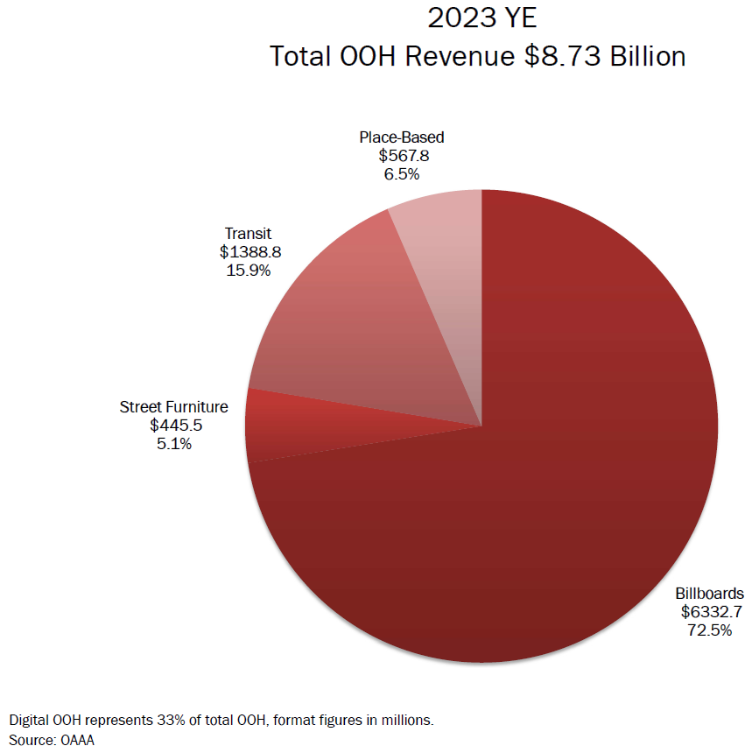
OOH Ad Spend Grew 2.1% to $8.73 Billion
2023 Category Performance vs. 2022
Billboards +2%
Street Furniture -8%
Transit +7%
Place-Based +2%
+10%
DOOH Growth
Notes:
Billboards do represent the lion’s share of OOH – last year accounting for almost 73% of total OOH spend.
Transit was the fastest growing OOH category in 2023, as more consumers returned to frequent commuting patterns.

Slide 4
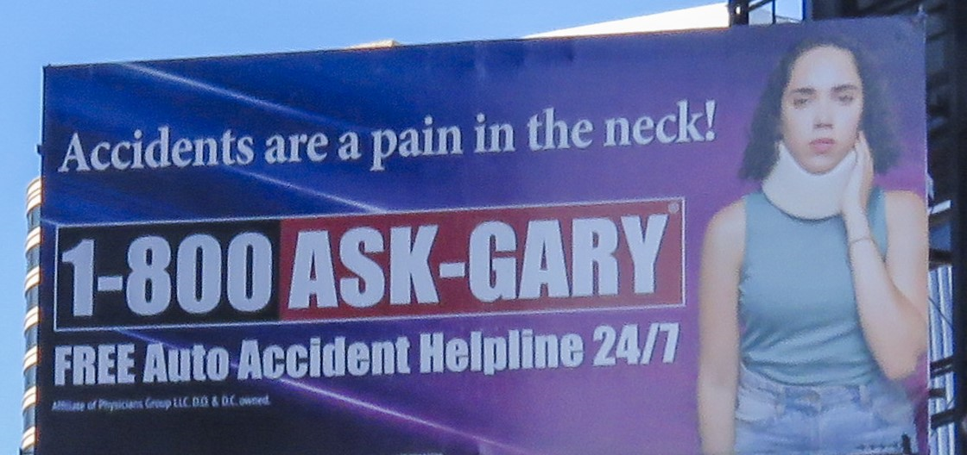
OOH Ad Spend: Top 25 Product Categories
Legal Services
Hospitals, Clinics & Medical Centers
Domestic Hotels & Resorts
Consumer Banking
Quick Serve Restaurants
Colleges & Universities
Local Government
Chain Food Stores & Supermarkets
Television & Cable TV
Religious, Charitable & Humanitarian Organizations
Apparel
Real Estate Agents, Agencies & Brokers
Live Theater, Opera, Music, Dance
Medical & Dental Insurance
Motion Pictures
Fuel Suppliers, Plumbing, HVAC Services
Computer & Software Stores & Services
Architects, Contractors, Engineers
Casual Dining Restaurants
Amusements & Events
Computer Software
Jewelry Stores
Wireless Telecom Providers
Organizations
Local Restaurants
The top 25 product categories account for 52% of total OOH spend
Source: Vivvix (a MediaRadar Co.)
Notes:
About 2/3s of OOH spend is invested by local businesses and agencies, with the other third represented by national business.
Here you see the top 25 product categories for OOH spend and collectively they account for over half of total OOH.

Slide 5
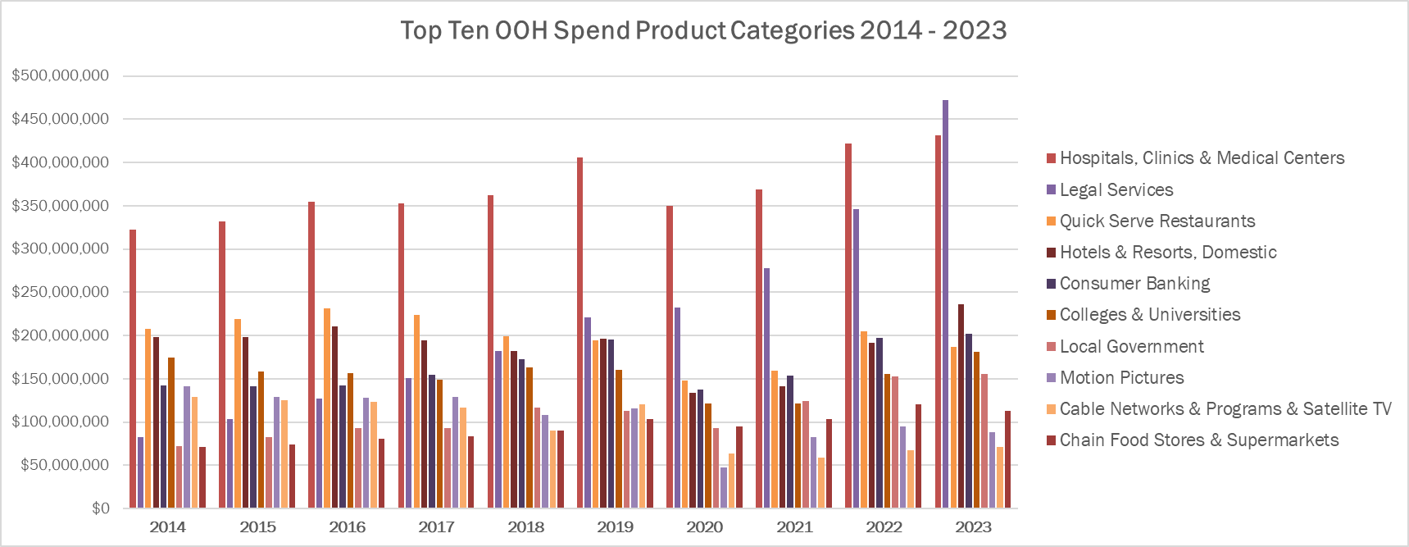
OOH Ad Spend: Product Category Trends 2014 - 2023
Hospitals/Clinics/Medical Centers replaced by Legal Services as Top Category in 2023
NOTE: OAAA estimates Vivvix under reports OOH spend by approximately 25%, so data in this chart is best used for longitudinal analysis.
Source: Vivvix (a MediaRadar Co.)
Notes:
Hospitals, Clinics and Medical Centers has been the top category for OOH spend over many years, but last year Legal Services rocketed to the top position and is also tracking as the top category again in 2024.

Slide 6
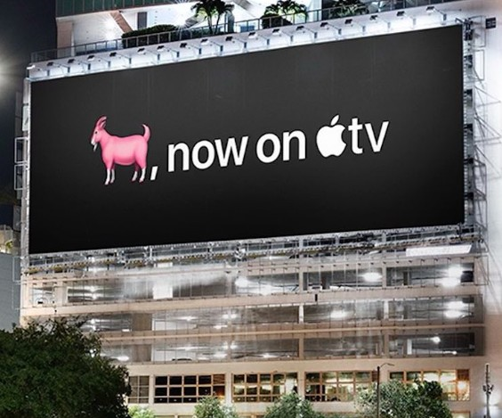
Top Ten OOH Advertisers and Parent Companies
Advertisers
Apple
McDonald’s
Disney
Coca-Cola
Amazon
Uber
T-Mobile
American Express
Coors
Dunkin’
Parent Companies
Walt Disney Company
Comcast Corp.
Apple Inc.
McDonald’s Corp.
Molson Coors Brewing Co.
Paramount Global
LVMH Moet Hennessy Louis Vuitton SA
Coca-Cola Co.
Amazon.com Inc.
Warner Bros Discovery Inc.
Access the full 2023 MegaBrands report here
Source: Vivvix (a MediaRadar Co.)
Notes:
Many of the same brands maintain a consistent position among our top advertisers, and these were the top ten OOH advertisers in 2023.
Because of OOH’s strength in driving online activation, many top technology brands remain highly committed to their use of our channel.
While McDonald’s has been the number one OOH brand for most of the past three decades due to our ability to drive sales in their physical stores, Apple has displaced them for the top spot the past two years.

Slide 7
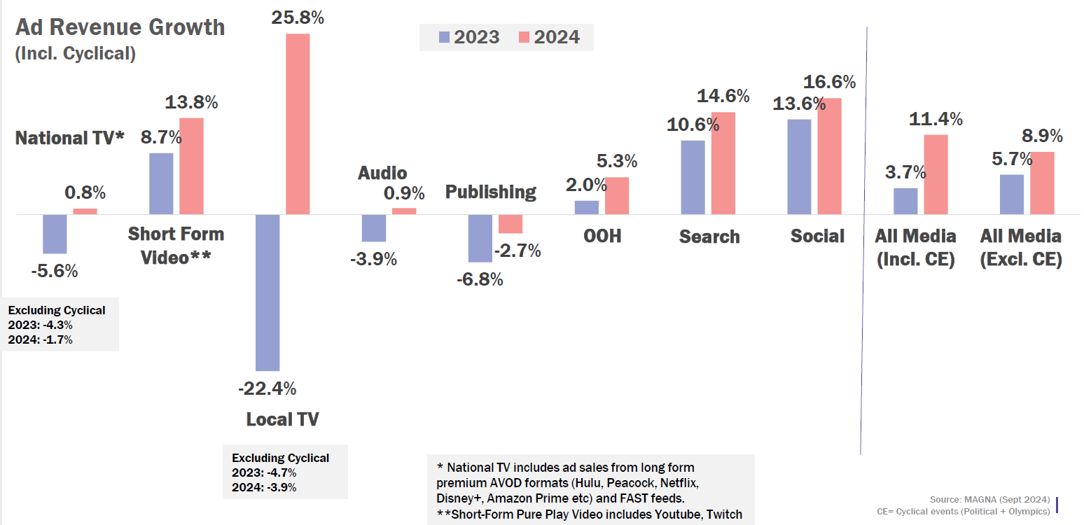
US Total Core Media 2023 Growth + 2024 Forecast
2023
Total media grew 5.7%
OOH grew 2.0%
2024 MAGNA Forecast
Total media growth of 8.9%
OOH growth of 5.3%
Notes:
IPG Mediabrand’s MAGNA forecasts OOH growth of over 5% this year, which would be the channel’s fourth fastest annual growth rate in the past 16 years.

Slide 8
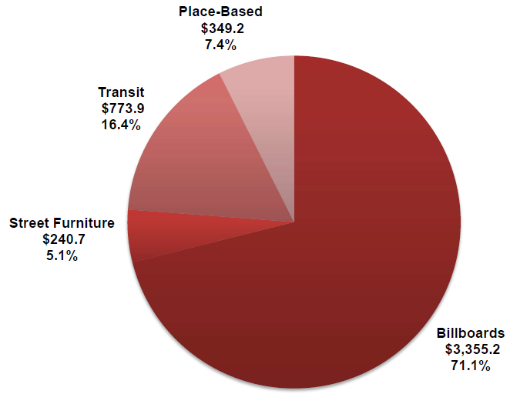
H1 2024: OOH Spend Grew to Record High $4.72 Billion
H1 2024 vs. H1 2023 Category Performance
Billboards +3.4%
Street Furniture +0.2%
Transit +15.6%
Place-Based -0.7%
+8.7%
DOOH Growth
Digital OOH represents 33% of total OOH, format figures in millions.
Source: OAAA
Notes:
For the first half of 2024, Billboards continue to represent the lion’s share of OOH, at just over 71% of total OOH spend.
Transit is the fastest growing OOH category YTD in 2024, with an impressive double digit growth rate of 16%.

Slide 9
Consumer Journey & Experience
Notes:
OOH’s place as the world’s oldest form of advertising, and one that is highly relevant today, is rooted in our ability to connect with consumer audiences.

Slide 10
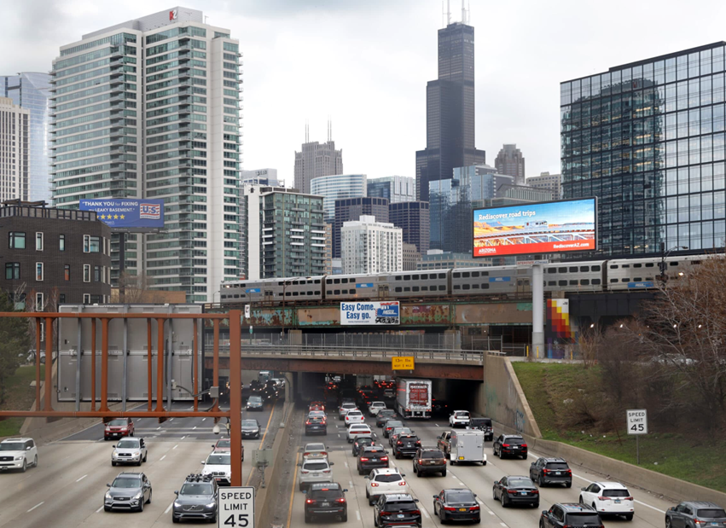
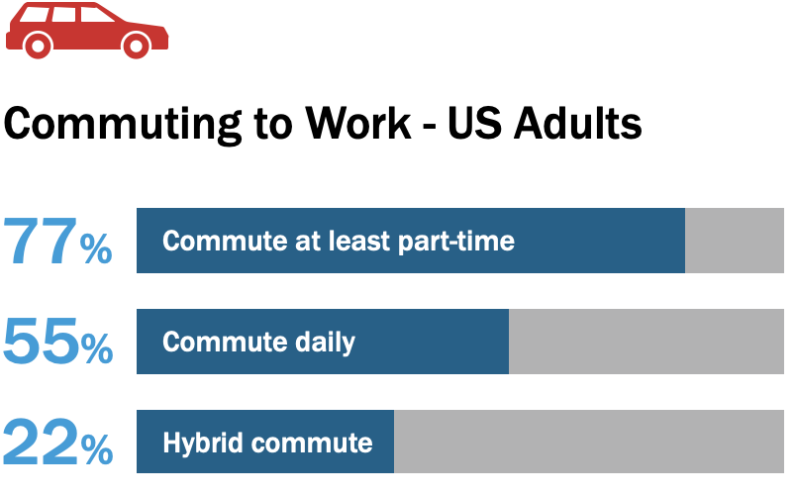
YTD 2024 Auto Travel Exceeds 2019 + Almost 80% Commute
US Travel: Millions of Vehicle Miles
January–July 2024 = 1,897,967 million
January–July 2019 = 1,889,100 million
Source: Morning Consult
Notes:
https://www.fhwa.dot.gov/policyinformation/travel_monitoring/24jultvt/24jultvt.pdf
OAAA has been focused on tracking consumer behavior to understand the new post-pandemic “normal”.
Research we conducted with Morning Consult revealed over three-quarters are back to commuting at least part-time and over half are commuting full-time.

Slide 11
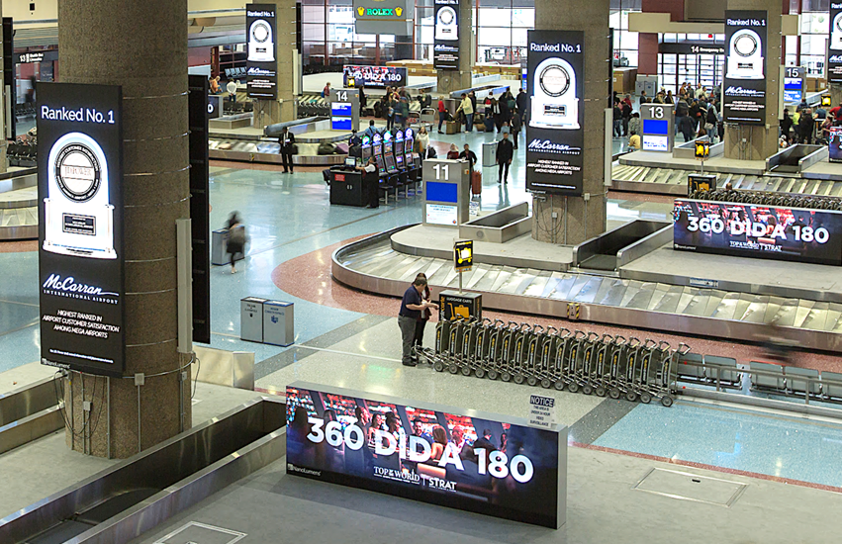
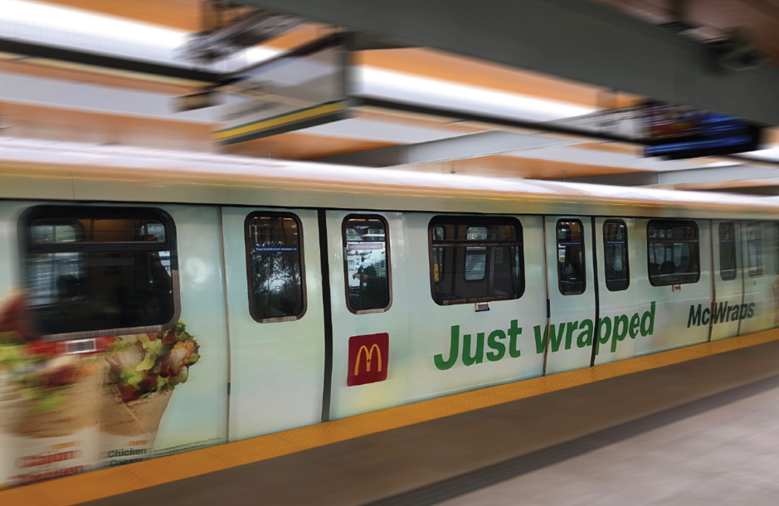
Transit and Airport Volume Continue to Grow
US Air Travel
Up 6.2% August 2023–July 2024 vs. the previous 12 months
US Transit Ridership
Up 8% in H1 2024 vs. H1 2023
Bus ridership up 9.8% in H1 2024 vs. H1 2023
Source: APTA, US DOT
Notes:
And air travel is booming, reaching and exceeding 2019 levels at various points so far in 2024.
While transit and urban rail ridership levels remain below peak levels of a few years ago, they continue to rebound, and are producing gains of 8% plus when comparing the first four months of 2024 versus the same period last year.
Transit Ridership - https://www.apta.com
https://www.apta.com/wp-content/uploads/2022-Q2-Ridership-APTA.pdf
Air Travel - https://www.transtats.bts.gov/Data_Elements.aspx?Data=4

Slide 12
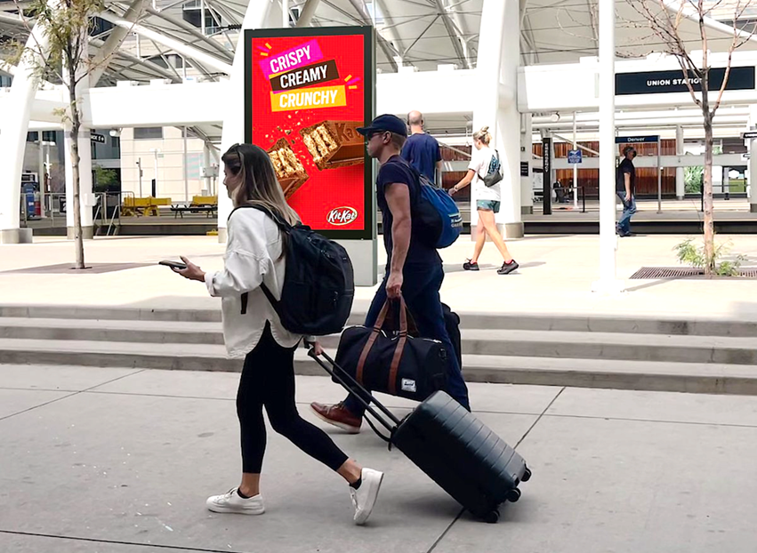
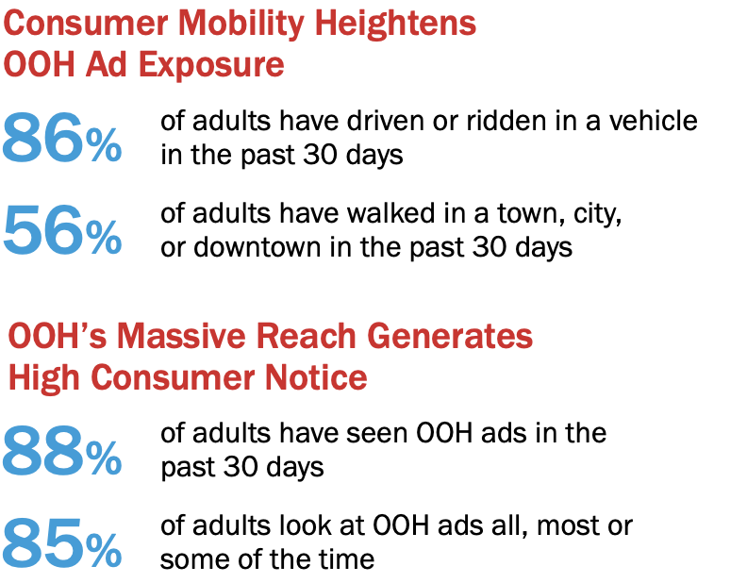
Consumer Mobility + OOH Reach Drives Ad Notice
Source: Morning Consult
Notes:
Consumer mobility anchors OOH’s success and we see here how OOH’s reach generates results for advertisers.
Almost 90% of consumers have seen an OOH ad in the past month and a similar number report looking at OOH ads.

Slide 13
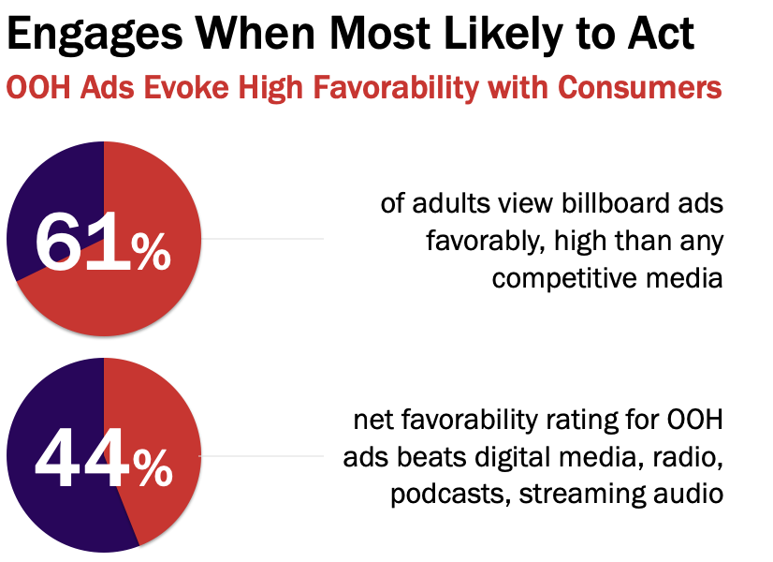
OOH Complements Consumer Experiences, Engages When Most Likely to Act
Source: Morning Consult
Notes:
OOH’s also generates success because it naturally complements many consumer experiences.
It doesn’t disrupt consumers, but rather complements their daily travels and activities.
These factors result in billboards generating the highest consumer favorability of any ad channel.

Slide 14
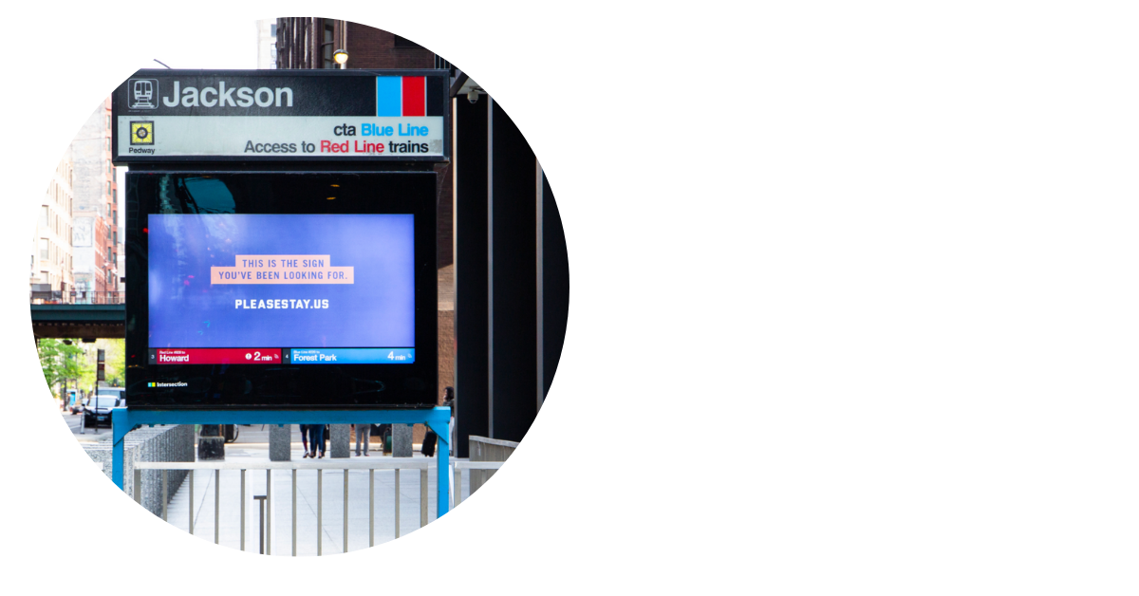
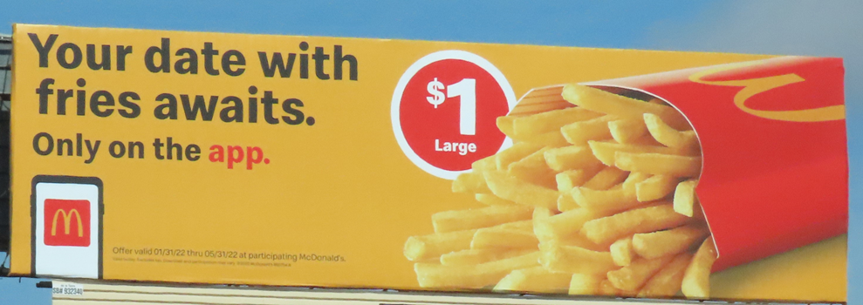
Consumers Are Highly Engaged With OOH
Source: The Harris Poll
Notes:
The Harris Poll found 85% of US adult consumers who have recently viewed OOH ads found them useful.
The OOH messages that resonated best conveyed information about special offers and promotions

Slide 15
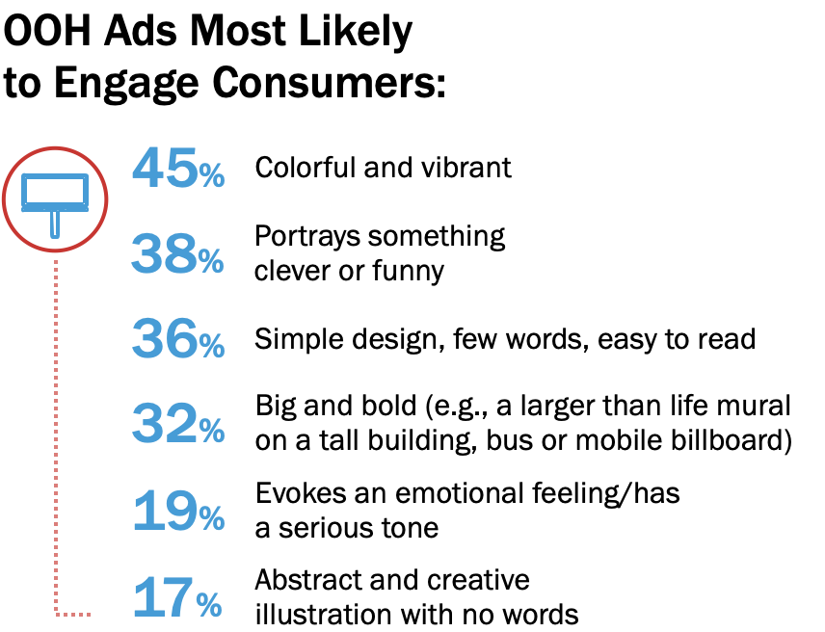
OOH Ads Most Likely to Engage Consumers: Colorful, Clever and Clear
Source: The Harris Poll
Notes:
And research from the Harris Poll supports what most OOH professionals know very well - ads that resonate best with consumers reflect these principles:
Colorful, witty, bold, simple messages will best engage consumers and produce results for OOH advertisers.

Slide 16
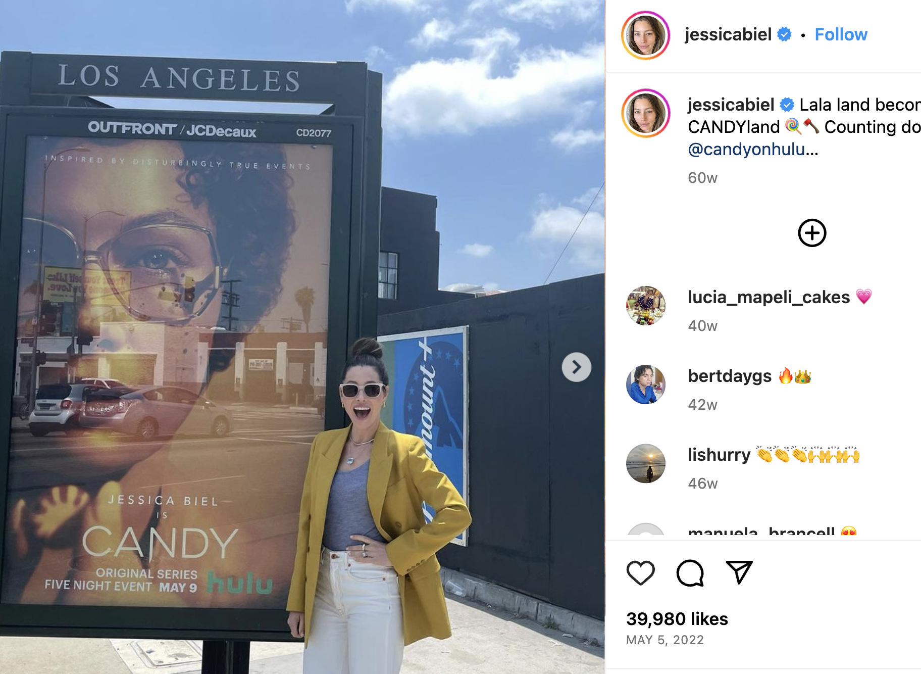
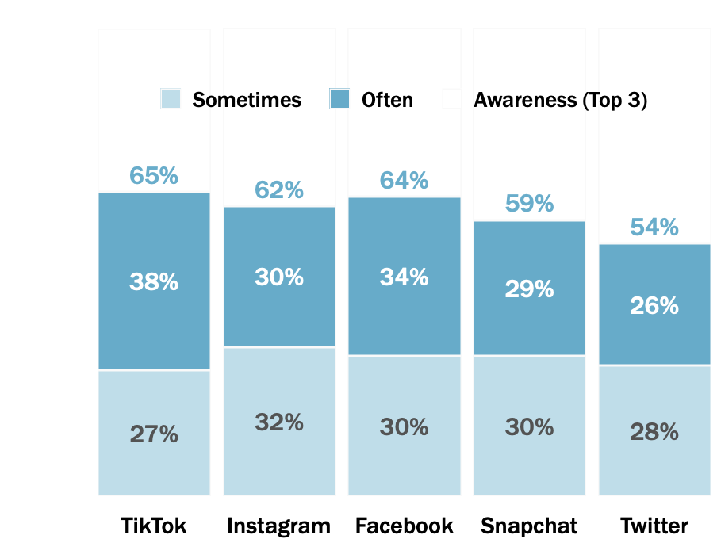
Social Media Users Notice OOH Ads Posted on Platforms
How often do you see out of home advertisements reposted on the following social media platforms?
Among users of each social media platform
Source: The Harris Poll
Notes:
OAAA research with The Harris Poll details the high level of earned impressions OOH generates by appearing a second time on social media platforms – including Tik Tok.
About 2/3s of their users report seeing OOH ad reposted on TikTok.

Slide 17
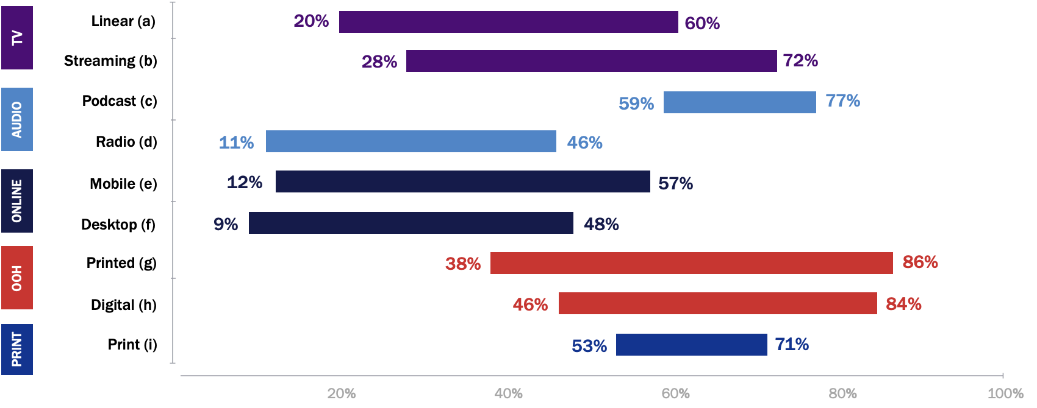
OOH Generates Highest Ad Recall of All Core Media
Source: Solomon Partners
Notes:
And OOH’s massive reach, combined with consumer favorability toward our medium, helps OOH generate the highest ad recall of all ad channels.

Slide 18
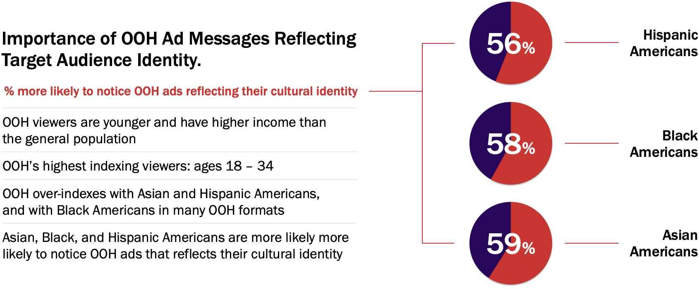
OOH’s Valuable Audience
44
Source: The Harris Poll, Morning Consult
Notes:
OOH offers unrivaled reach and connects with consumers viewed as the most lucrative by many brands – younger, more affluent audiences.
And in our increasingly diverse society, OOH over-indexes with the fastest growing demographic segments Asian, Black and Hispanic Americans.
OOH is at its most effective when highly relevant to the target audience, and research shows the best way to engage multicultural audiences is to use creative that reflects their cultural identity.

Slide 19
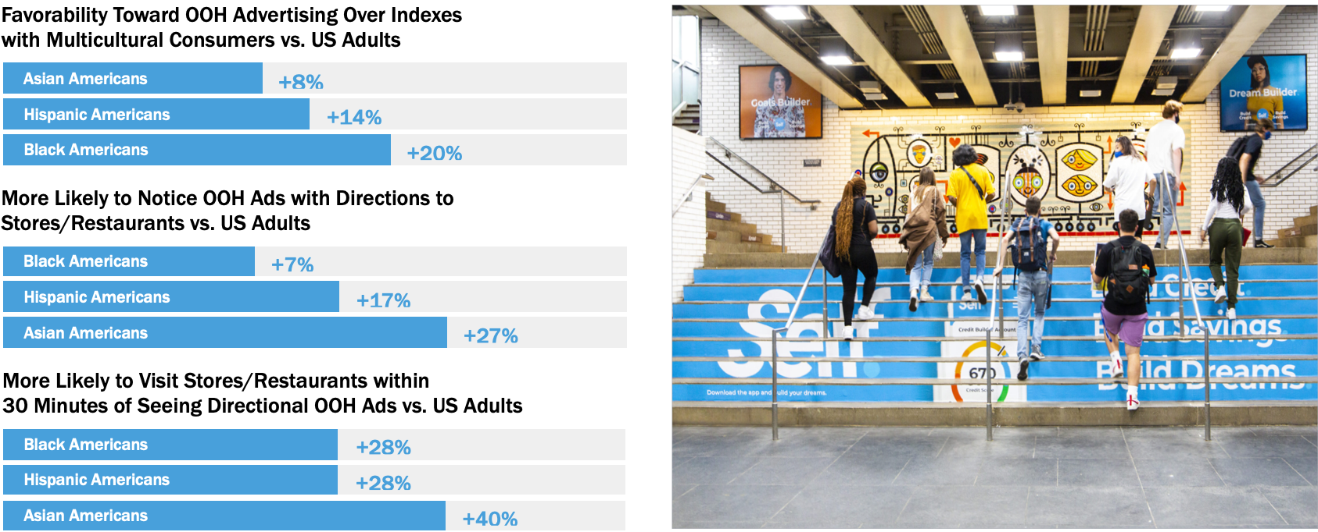
OOH Resonates with Multicultural Consumers
Source: Morning Consult
Notes:
And to underscore the importance of aligning the creative message to the target audience – OOH over indexes on favorability among multicultural consumers.
Those same multicultural audiences are more likely to notice OOH directional ads to businesses AND to visit those businesses soon after seeing the OOH ad.

Slide 20
OOH Effectiveness
Notes:
As Haylee noted in her introduction, the OOH industry understands producing results for our clients is of critical importance.

Slide 21
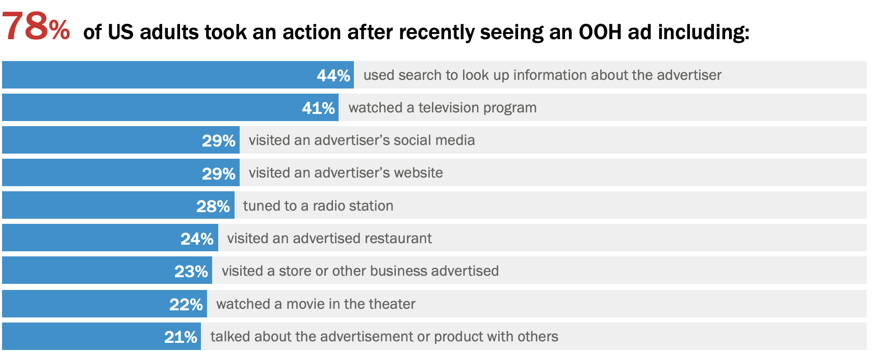
Almost Four in Five Act Following Recent OOH Ad Exposure
Source: Morning Consult
Notes:
And OOH delivers results in impressive fashion.
Almost 4 in 5 recent OOH ad viewers took an action after exposure with search being the top action generated.

Slide 22
OOH Engages Consumers On Journeys to Retail Stores
Source: Morning Consult
Notes:
Retail media is one of the hottest topics in today’s marketing economy and OOH plays a critical role in the retail shopping ecosystem.
Almost 70% of consumers report noticing OOH ad on their way to shop in physical stores, and jumps to over 70% among multicultural audiences.

Slide 23
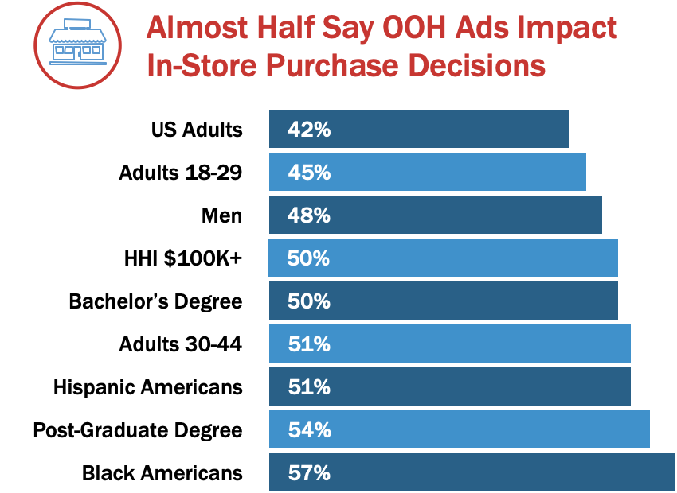
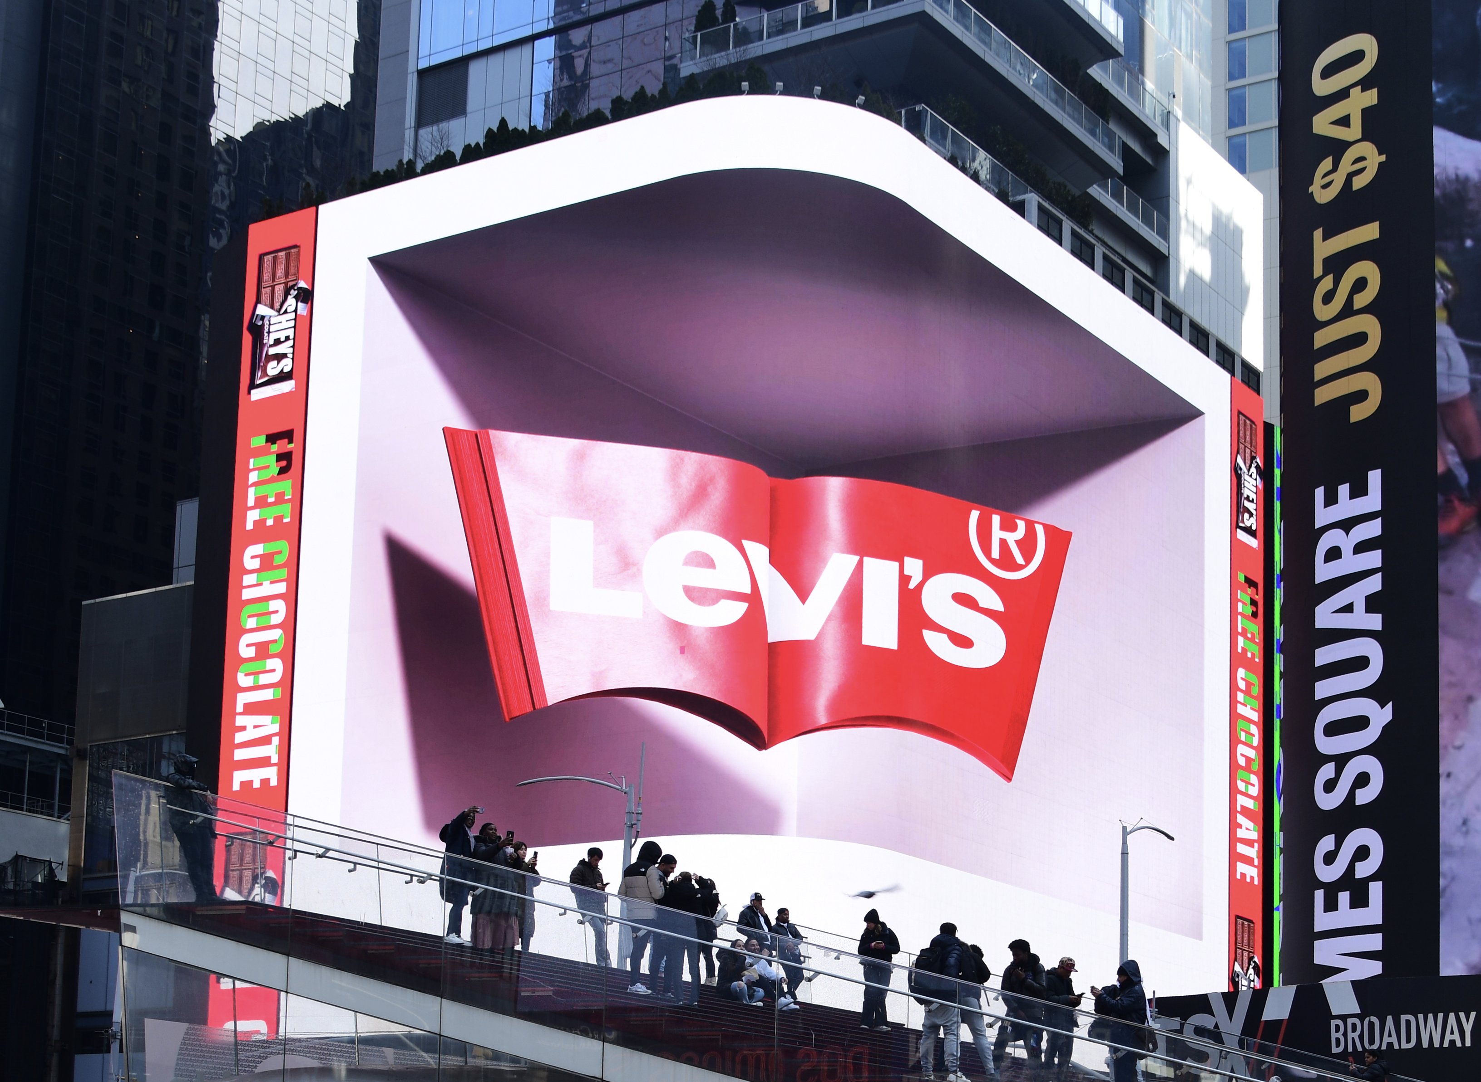
OOH Influences Consumer Purchase Decisions
Source: Morning Consult
Notes:
And beyond notice, over 40% of consumers report OOH ads influence their in-store purchase decisions, with even greater impact among younger, more affluent and multicultural audiences.

Slide 24
OOH Primes Mobile Activation
Source: Morning Consult
Notes:
The ability of OOH to prime mobile engagement cannot be overstated – Over three quarters of consumers were recently prompted to take an action on their mobile device following exposure to an OOH ad.
This is a major competitive advantage OOH offers in an advertising ecosystem where 2/3's of all ad spend is mobile.

Slide 25
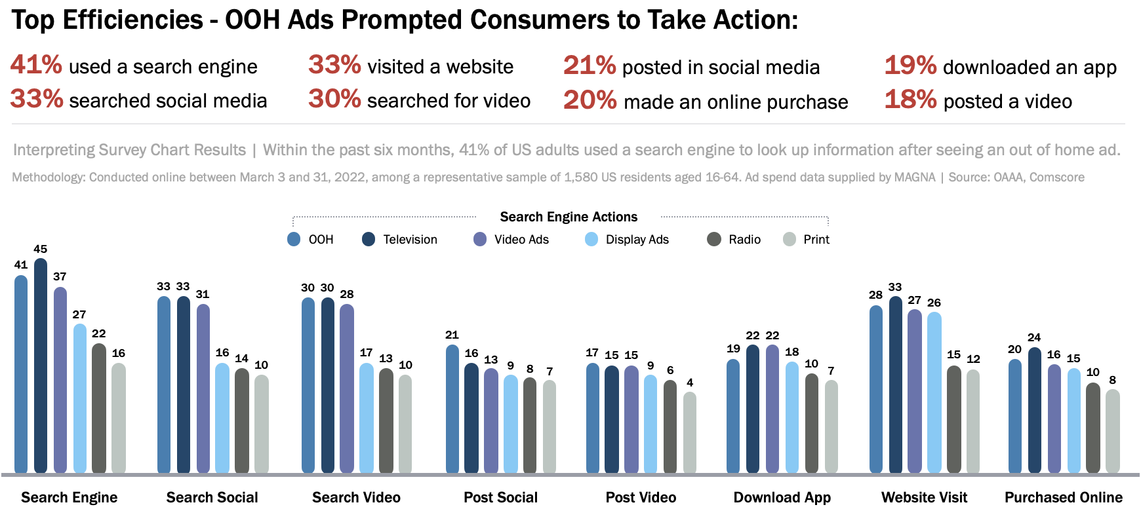
OOH Most Efficient at Driving Online Activation
Source: Comscore
Notes:
OOH offers an unrivaled ability to drive online activation.
In research from Comscore, they found per ad dollar spent, OOH was more efficient in driving activation than Video, Print, Radio or online display ads.
OOH highest levels of efficiency occur in driving search, website visitation and social activation.

Slide 26
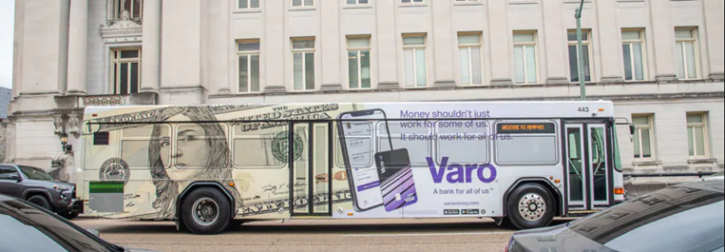
OOH Ads Amplify All Media Plans – Delivers Huge Boost to Search ROI
+40%
OOH boosts ROI of Search
Source: Benchmarketing
Notes:
The high consumer notice of OOH ads also helps generate this important statistic – OOH boosts the ROI of Search campaign investment by 40%,
Almost all consumers have a mobile device with them when away from home, so OOH serves as a natural prompt to drive mobile activation – we are big screens driving consumers to small screens.

Slide 27
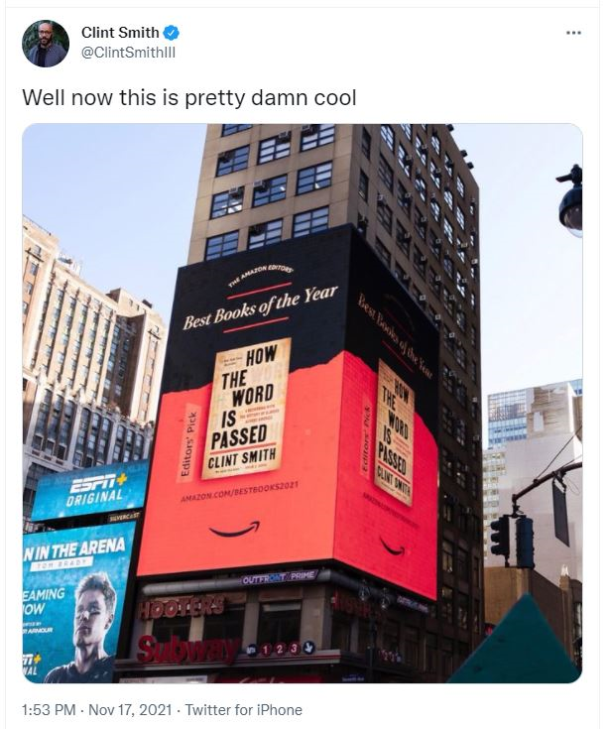
OOH Engages Gen Z + Millennials – Reaches Them Again on Social Media
Source: The Harris Poll
Notes:
OOH over-indexes with younger, more affluent and educated audiences, and these are the same consumers most engaged with social media.
And with the ease which clever, timely, creative OOH ads can be shared, it’s no surprise over two-thirds of Gen Z and Millennials have seen OOH ads reposted in social media.
OOH delivery to brands of highly valuable amplification on social media is another aspect differentiating OOH from most competitive media channels.

Slide 28
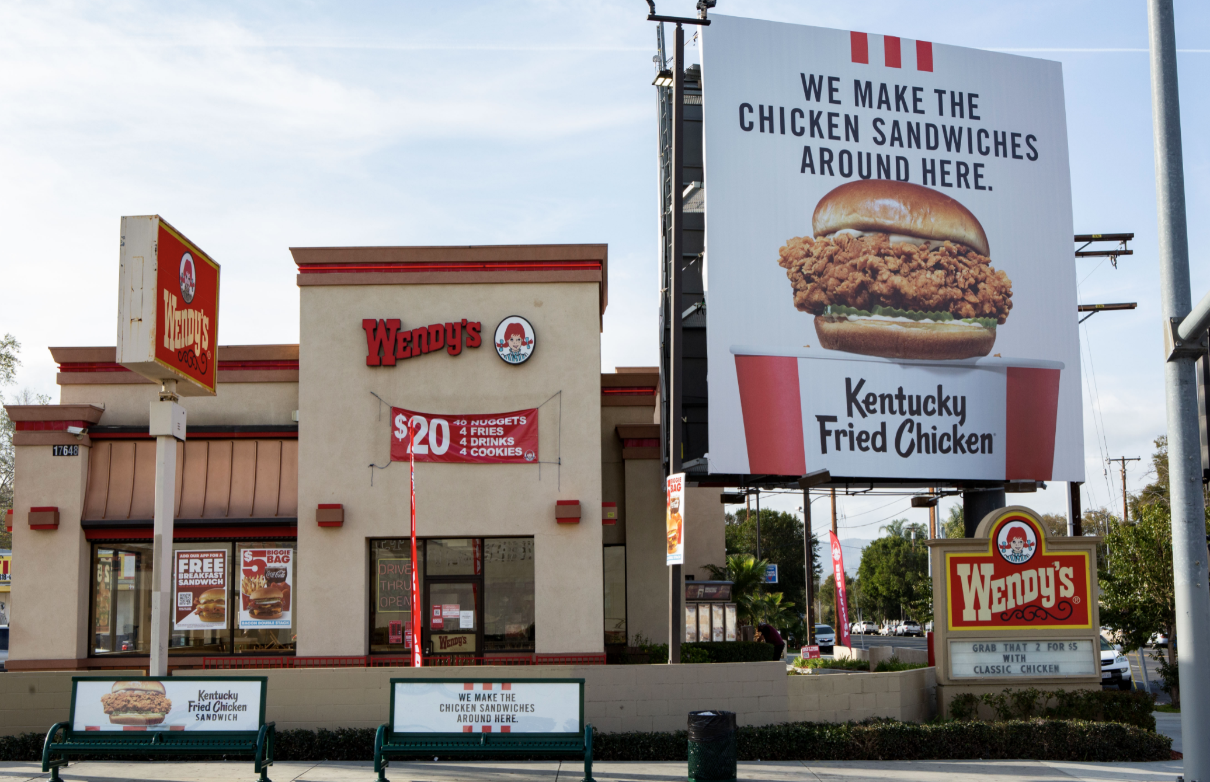
OOH Key Product Category Ads Most Relevant to Consumers
Source: The Harris Poll
Notes:
And tying back to OOH’s natural ability to engage consumers when they are most likely to act or respond, the product category OOH ads consumers find most relevant are retail, QSR, food and beverage, and health service categories.

Slide 29
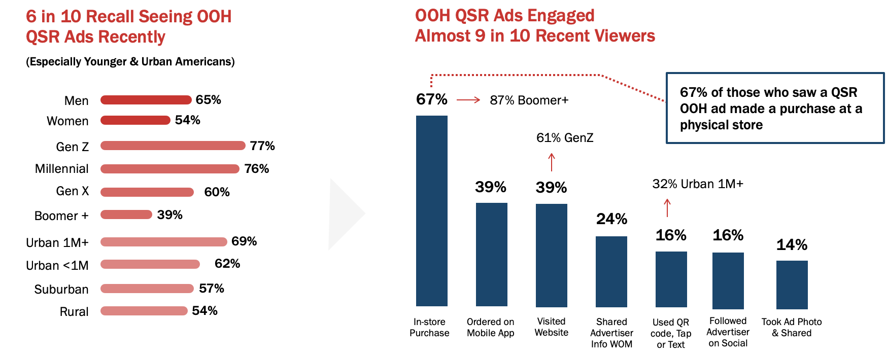
OOH Reaches QSR Consumers Drives Sales
Source: The Harris Poll
Notes:
QSR is one of OOH’s most top performing categories, and our Harris Poll research makes clear why OOH is an important component of the fast food media mix.
McDonald’s is the classic OOH case study, having earned the top spot in OOH spend for most of the past several decades.
Among US adults 18+, 60% of consumers recently noticed OOH ads for QSR restaurants, and even higher notice rates occur with young generations and urban audiences.
And what’s truly impressive is OOH’s conversion from consumer notice to consumer action which occurs with almost 90% of recent OOH QSR ad viewers. Leading those consumer actions is in-store purchasing which occurs among 67% of the viewers.

Slide 30
OOH Impact with Key Product Categories
OOH impact in driving notice and engagement, along with ad message content most likely to resonate with consumers
Alcoholic Beverages
Automotive
Cannabis
Financial Services
Healthcare Services
Home Improvement/Hardware Stores
Hotels
Insurance Services
Legal Services
Luxury Apparel
Pharmaceuticals
Political
Quick Service Restaurants
Sports Betting
TV/Video Streaming Services
Notes:
We have similar research on OOH impact across this broad range of categories, so please let us or your OOH media companies know if you’d like to receive these product-specific recaps.

Slide 31
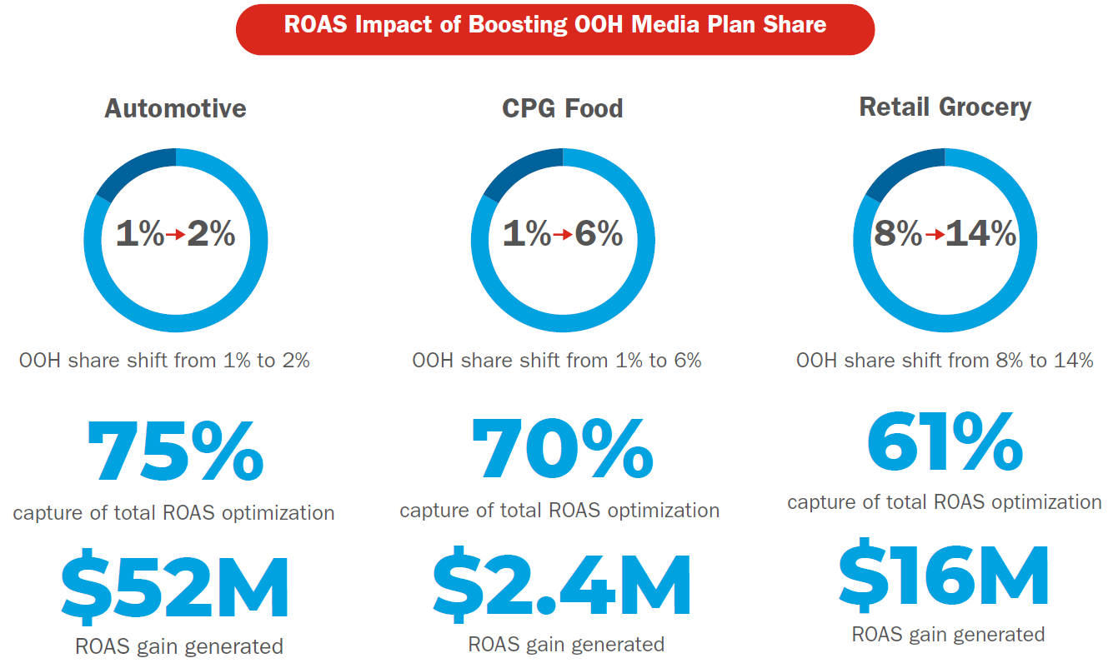
OOH: Improve Brand Sales ROI With Reallocation of Existing Budgets
Increased OOH allocation boosts media plan sales ROI at no additional cost
Notes:
At this point in OOH’s evolution, there can be no doubt about our channel’s ability to deliver both brand awareness and to drive consumer action.
We understand it’s incumbent for our industry to continually provide evidence to clients on OOH’s value and ability to generate results.
Our latest research with Benchmarketing, a data analytics division of Omnicom, proves increasing allocation of OOH share of plan leads to improved ROI for the overall plan.
Here you see a summary of the Sales ROI analysis.

Slide 32
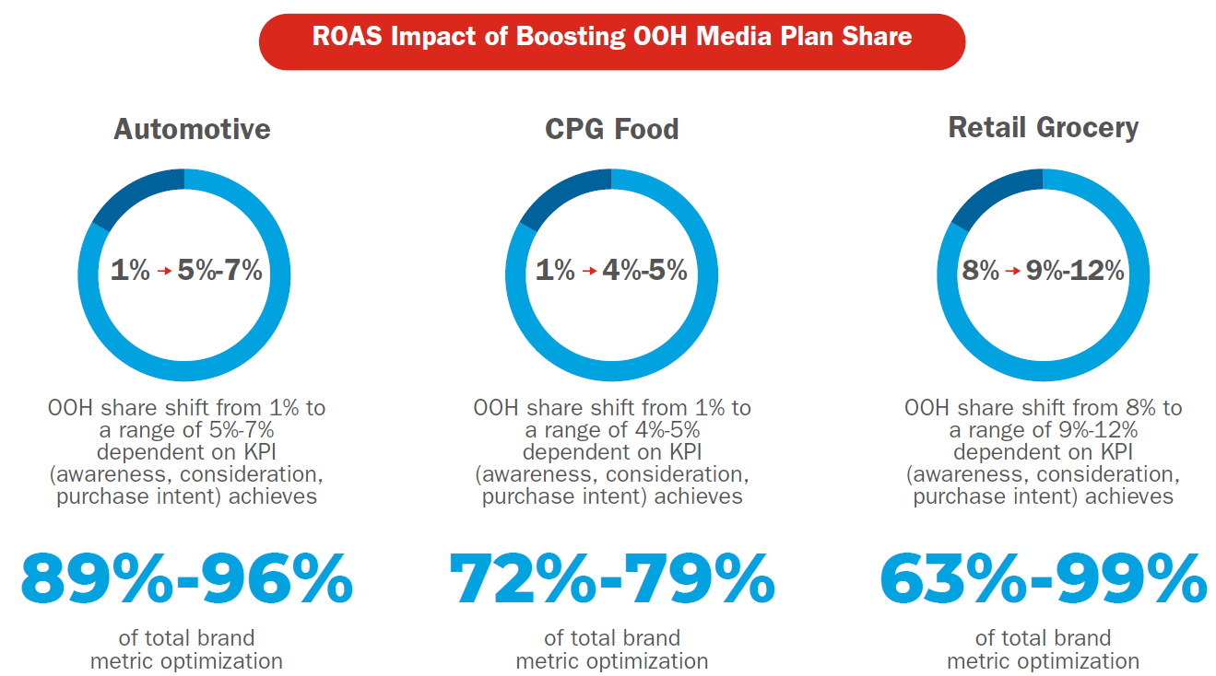
OOH Performance Measurement: Brand Metric Scores ROI
Increased OOH allocation boosts media plan brand metric scores at no additional cost
Notes:
And this summary page is for the Brand Metric scores improvements in Awareness, Consideration and Purchase Intent.

Slide 33
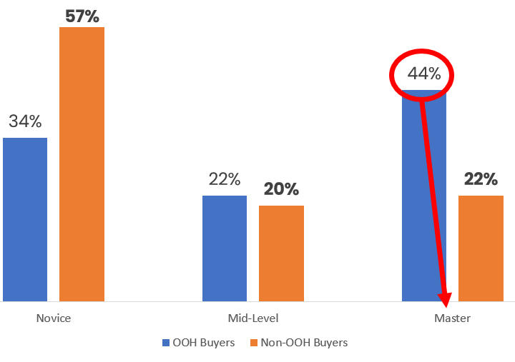
Local Advertising Master Marketers More Inclined to Buy OOH
Source: Borrell
Notes:
The market research firm Borrell examined survey results from local businesses generating $1M or more in annual revenue and then segmented the marketing decision-makers into Novices, Mid-Level or Masters, based on length of marketing experience.
They found that marketers with a master level of experience were 2X more likely to buy OOH when compared to novice marketers.
Master marketer = 10K hours of marketing experience

Slide 34
Digital Transformation
Notes:
As we’ve shared, DOOH is playing a key role for our industry and that trend will only continue to gain momentum.

Slide 35
Digital: Key Growth Driver for OOH
10%
DOOH
Revenue
Growth
In 2023
16%
DOOH
Projected
Growth
In 2024
18K
Digital Billboard Units
2024
Source: MAGNA, OAAA
Notes:
While all format categories of OOH are projected to grow in 2024, the digital OOH segment will lead the way, with a forecasted increase in the 16% range.
The immediacy and flexibility of DOOH resonates with marketers who note it’s ability to impact both upper and lower funnel metrics.
And it’s expected to grow to 45% of total OOH by 2027.

Slide 36
Consumer Concerns with Competitive Digital Media
Source: The Harris Poll
Notes:
Beyond the technical restrictions being enforced on digital media, the pandemic drove increased consumer fatigue with the channel and worries about privacy.
About 4 in 5 consumers are annoyed with ads that disrupt their media consumption experiences.
Nearly 3/4s of them are concerned with privacy and ad targeting – mirroring the opt out rates I showed earlier – and almost 70% report they frequently skips online ads.

Slide 37
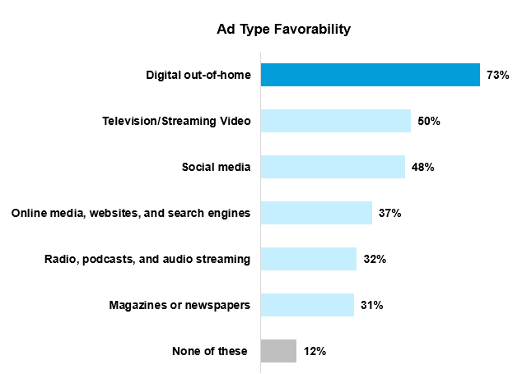
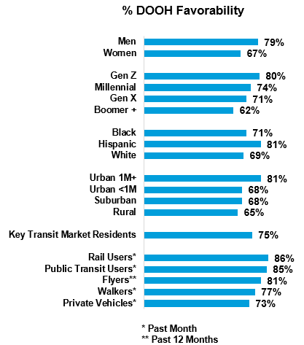
Digital OOH: Most Favorably Viewed Advertising Format
Consumers in large urban areas, transit users, and younger generations are most favorable toward DOOH ads.
Source: The Harris Poll

Slide 38
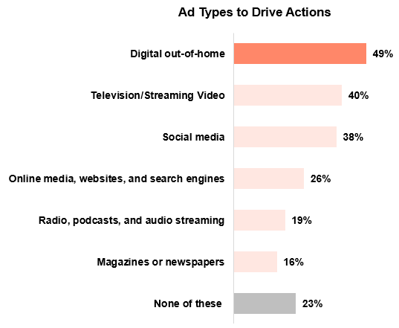
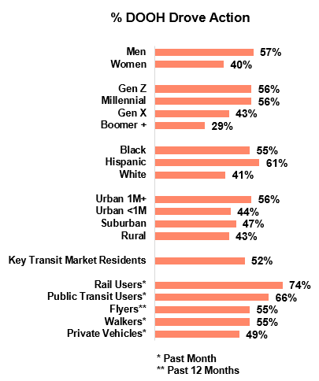
Digital OOH: Ad Format Most Likely to Drive Consumer Action
Consumers in large urban areas, transit users, and younger generations are most driven by DOOH ads to take action.
Source: The Harris Poll

Slide 39
Digital OOH Generates Consumer Engagement
62%
of consumers have recently noticed digital billboard ads
of viewers took action after seeing digital billboard ads (program tune in, dining, store visit or purchase)
78%
77%
of viewers engaged in a mobile device action (search, website visit, purchase, access discount)
Source: The Harris Poll
Notes:
The flexibility and immediacy of the messaging also resonates with consumers because it can often present the most relevant messages.
That’s why over 3/4s of DOOH viewers report taking an action after ad exposure and over half engaged in a mobile device action.

Slide 40
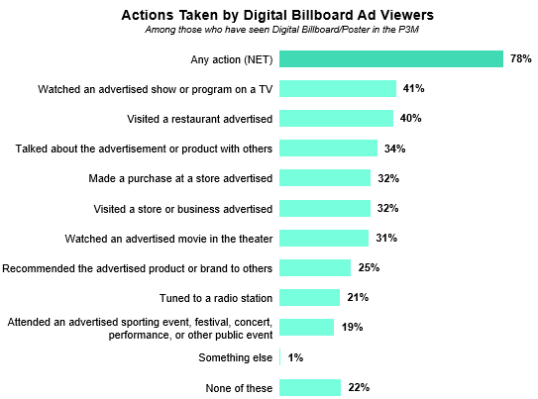
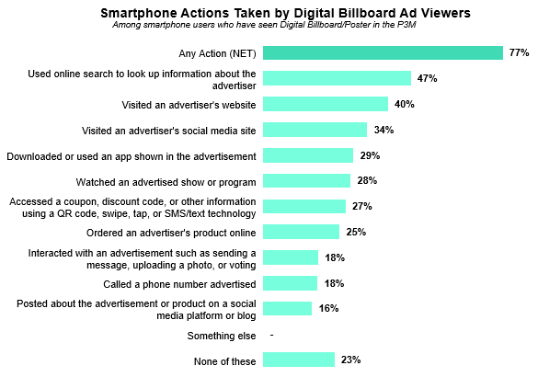
Consumer Actions Most Likely Driven by DOOH Billboard Ads
Source: The Harris Poll

Slide 41
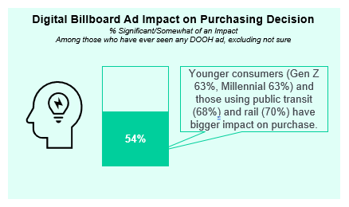
DOOH Ads Impact Purchasing Decisions of Over Half of Consumers
Source: The Harris Poll

Slide 42
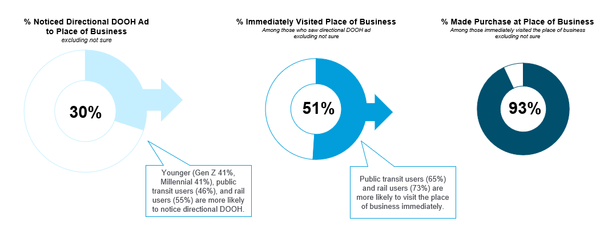
Directional DOOH Ads Drive Consumer Purchases
Among the third of consumers who have recently noticed directional DOOH ads, half visited the place of business immediately and nearly all of those made a purchase.
Source: The Harris Poll

Slide 43
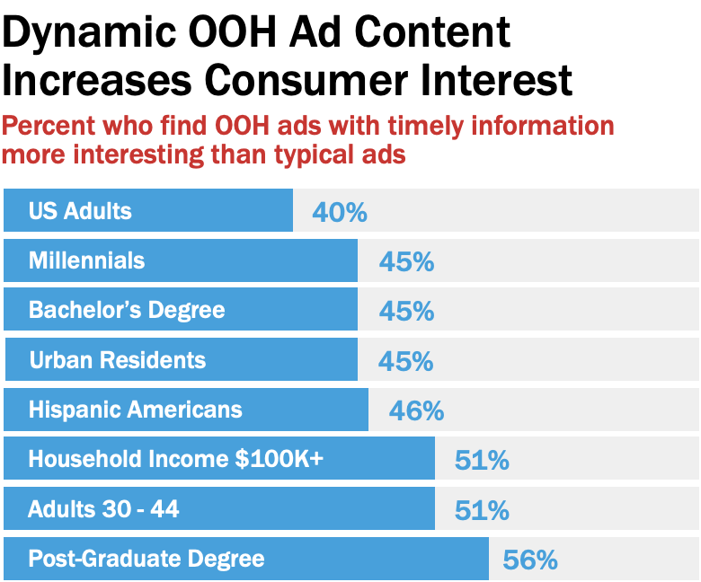
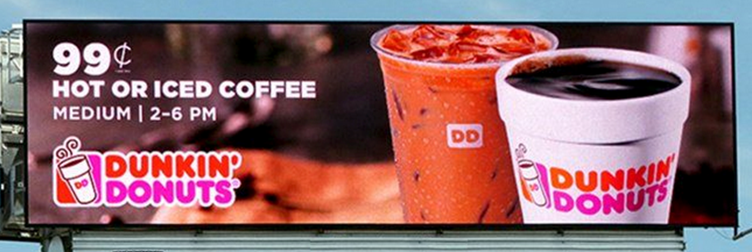
Nearly Half Say Contextual OOH Ads Are More Interesting
Source: The Harris Poll
Notes:
When marketers leverage the power of DOOH to deliver creative ad messages at the right time and right place, the results can be quite impressive.
Almost half of all OOH ad viewers, and almost two-thirds in cities of 1M+, find contextual OOH ads of greater interest.

Slide 44
DOOH Ad Content Most Likely to Drive Consumer Engagement
Source: The Harris Poll

Slide 45
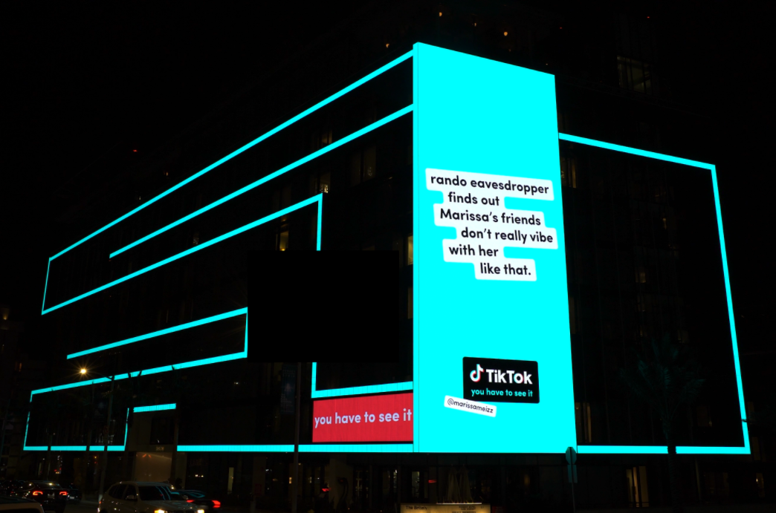
Programmatic: Significantly Expanding DOOH Opportunities
Omnichannel Demand-Side-Platform integrations into DOOH Supply-Side Platforms continue to grow
Programmatic DOOH:
Will represents over a quarter of DOOH in 2024
This year’s volume will be more than double 2022
Projected to grow to over $1B in 2025
Projected to be over 30% of DOOH in 2026
Key Drivers:
Shorter lead times
Greater flexibility
Aggregated Scale
Consistent targeting/data
v
Source: eMarketer
Notes:
The rapid rise of programmatic DOOH has greatly enhanced our overall growth potential by offering digital media planners another robust, efficient way to reach their target audiences.
This year, programmatic DOOH is forecast to double volume from just two years ago and approach $1 billion.

Slide 46
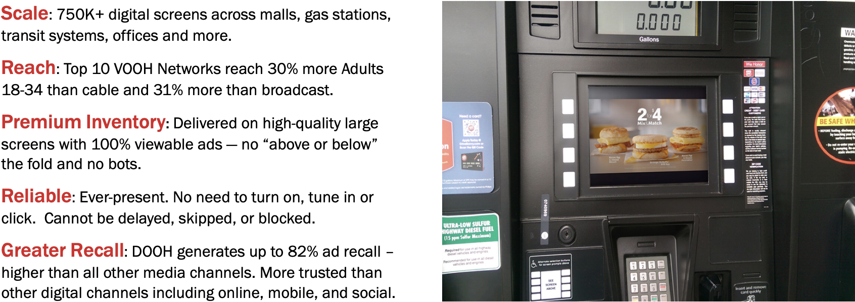
VOOH Attributes & Competitive Advantages
Source: Nielsen, Solomon Partners, Marketing Sherpa
Notes:
As cable subscribers continue to decline and over the top TV viewing increases, TV audience fragmentation in an ongoing challenge for most marketers.
Video OOH offers a highly valuable alternative with its massive reach and ability to connect with key demographic segments.
The top ten VOOH networks reach 30% more adults 18 -34 than cable or broadcast TV – and with ad delivery that can’t be skipped or blocked.

