Slide 1
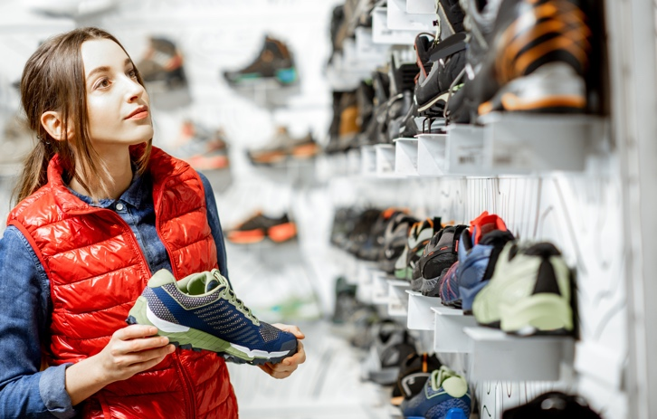
VISIT STUDY
The programmatic DOOH campaign delivered a significant lift in visits to the brand’s stores, while also driving consumers to act quickly and travel farther to get to the stores.
DOOH boosts store visits for sneaker brand
125% Lift
OBJECTIVE Increase brand awareness and visitation for a sneaker brand’s retail stores in New York.
SOLUTION Expand the brand’s omnichannel campaign with a high-impact programmatic DOOH overlay through the brand’s preferred DSP. Target New Yorkers and commuters with iconic digital Spectaculars in Midtown and Times Square.
50%
of exposed audiences visited a store within
2 days of seeing the DOOH ads
81%
of visitors who saw the DOOH ads traveled 5+ miles from home to visit the retail store
Source: CCO RADARProof; Cuebiq, August 2022 | Lift confidence level: 90%
Notes:
Plan Details:
Market: New York
Campaign Timing: 6/13/2022 – 8/31/2022 (11 Weeks)
OOH Formats: Digital Bulletins
Impressions: 12.9MM

