Slide 1
The Effectiveness of Digital OOH Advertising
May 2024

Slide 2
Table of Contents and Methodology
Introduction: Table of Contents and Methodology
Introduction | 2
Key Findings | 3
Audience Definitions | 4
Detailed Findings | 5
The State of DOOH Advertising | 6
DOOH Category Deep Dive | 18
DOOH: Amplifying and Innovative | 23
Demographics | 33
Appendix | 35
Field Dates | April 2 – April 9, 2024
Survey Length | 10 minutes
Method | Online
Audience | n=1,023 U.S. Adults ages 18-64
Data is weighted to reflect the U.S. general public across age, gender, race/ethnicity, region, income, household size, and employment.
“The Effectiveness of Digital OOH Advertising” study was sponsored by The Foundation for Out of Home Advertising Research and Education (FOARE), a 501 (c) (3) not for profit, charitable organization.

Slide 3
Key Findings
OAAA DOOH
DOOH is a Highly Effective Advertising Medium.
DOOH is a favorable and motivating channel, particularly among younger generations and those in large urban areas as well as for public transit and rail users.
73% of consumers view DOOH ads favorably, significantly higher than competing ad media (video, social media, print, audio, online).
Men, Gen Z and Millennials rank DOOH ads with the highest favorability.
DOOH spurs high action rates among those exposed.
DOOH ads are more likely to generate consumer action than any competing ad media, with almost half (49%) stating DOOH ads are likely to make them take an action.
76% of recent DOOH ad viewers have taken an action and the most frequently reported were: watching video programming (38%) restaurant visitation (36%), in-store purchasing (30%), word-of-mouth conversations (29%), and store visitation (29%).
Men, Gen Z, Millennials and Adults in key Transit markets are the most likely to act after DOOH ad exposure.
DOOH drives frequent engagement on mobile devices.
74% of mobile device users have recently taken a device action as a result of recent DOOH ad exposure.
44% of the actions were online searches about the advertisers.
38% were direct visitation to advertiser websites.
30% were visitation to the advertiser social media sites.
26% were use of or download of advertiser apps.
24% were use of device technology to access info or coupon/discount (QR code, swipe, tap, SMS/text).

Slide 4
Key Findings
OAAA DOOH
DOOH Drives Store Traffic + Impacts Retail Purchasing Decisions.
30% of consumers have recently noticed DOOH ads providing directions to a business.
51% of those who noticed the directional DOOH ad visited the business.
93% of those who noticed the directional DOOH ad and visited the business made a purchase.
77% of consumers notice DOOH ads when making purchases inside businesses.
Types of DOOH Ads that Generate Consumer Notice and Likelihood to Act.
At least half are more likely to notice DOOH ads featuring cost savings at grocery stores and restaurants, or upcoming movie releases.
Over 70% are likely to share DOOH ad content they deem entertaining (creative, clever, humorous) or that features their favorite products or brands.
Contextual, Dynamic DOOH Ads Drive Consumer Interest.
Dynamic ad content with deals, offers related to current weather conditions, and time-specific discounts are among those consumers consider most useful.
86% rate ads with special deals on groceries useful.
84% rate ads with special deals at restaurants useful.
81% rate ads with offers related to current weather conditions useful (temperature, precipitation, etc.)
80% rate ads with time-specific offers useful (food menus, beverages, etc.)
80% rate ads with special deals on clothing, shoes or accessories useful.
78% rate ads with notifications/reminders about local special events useful.

Slide 5
Audience Definitions
Introduction: Audience Definitions
Past Month Private Vehicle Users
Past Month Walkers
Past 12 Month Flyers
Have driven or ridden in a car, truck, or other private vehicle within the past month
Have walked in a town, city, or downtown are within the past month
Have taken a trip via airplane in the past 12 months
94% of adults 18-64 are past month private vehicle users, with 91% within the last week
72% of adults 18-64 are past month walkers, with 52% within the last week
54% of adults 18-64 are past 12-month flyers, with 38% within the last 6 months
Past Month Public Transit Users
Key Transit Market Residents
Past Month Rail Users
Have ridden as a passenger in a taxi, public bus, or ride-share car service within the past month
Live in the New York, Philadelphia, Boston, Washington, D.C., Chicago, or San Francisco DMA
Have ridden as a passenger on a commuter rail or subway in the past month
38% of adults 18-64 are past month public transit users, with 21% within the last week
21% of adults 18-64 are key transit market residents
17% of adults 18-64 are past month rail users, with 9% within the last week
Q100. When was the last time you…
Q105. When was the last time you took a trip via airplane?

Slide 6
Detailed Findings

Slide 7
The State of DOOH Advertising

Slide 8
Digital OOH is the most favorably viewed advertising format
The State of DOOH Advertising
Those in large urban areas, transit users, and younger generations are most favorable toward DOOH ads.
Ad Type Favorability
% DOOH Favorability
76%
Traditional Media NET
* Past Month
** Past 12 Months
Source: Harris Poll
BASE: ALL QUALIFIED RESPONDENTS (n=1,023)
Q200. Which of the following advertisement formats or locations do you find favorable?

Slide 9
Digital OOH is the ad format most likely to drive consumer action
The State of DOOH Advertising
Large urban residents, transit users, and younger generations are most driven by DOOH ads to take action.
Ad Types to Drive Actions
% DOOH Drove Action
63%
Traditional Media NET
* Past Month
** Past 12 Months
Source: Harris Poll
BASE: ALL QUALIFIED RESPONDENTS (n=1,023)
Q210. Which of the following advertisement formats or locations is likely to make you take an action?

Slide 10
Digital OOH ads generated action among three in four recent viewers
The State of DOOH Advertising
Watching an advertised show or visiting a restaurant were the top actions generated. Younger generations, transit users, and large urban residents are the most likely to act.
Actions Taken in Past 3 Months
Among those who have seen any DOOH ad in P3M
% Any Action
* Past Month
** Past 12 Months
Source: Harris Poll
BASE:HAS SEEN ANY DOOH AD IN P3M (n=807)
Q300. Have you done any of the following after seeing any form of digital out-of-home advertising in the past three months?

Slide 11
Digital OOH ads generated mobile device actions with three in four recent viewers
The State of DOOH Advertising
Online search or advertiser website visitation are the top mobile device actions generated. Younger generations and transit users are the most likely to act on their device.
Actions Taken in Past 3 Months
Among smartphone users who have seen any DOOH ad in P3M
% Any Action
* Past Month
** Past 12 Months
Source: Harris Poll
BASE: SMARTPHONE USERS WHO HAVE SEEN ANY DOOH IN P3M (n=739)
Q301. Have you done any of the following on your smartphone or mobile device after seeing any form of digital out-of-home advertising in the past three months?

Slide 12
77% of consumers noticed DOOH ads when making purchases inside businesses
The State of DOOH Advertising
Younger generations and transit users report the highest likelihood to notice these ads.
How Often Digital Signage and Video Screens Are Noticed In Places of Business
Among those who have ever seen any DOOH ad
% Notice All/Most of the Time/Sometimes
77%
All/Most of the time/Sometimes NET
24%
Never/Rarely NET
Source: Harris Poll
BASE: HAS EVER SEEN ANY DOOH AD (n=928)
Q230 How often do you notice advertising messages on digital signage or video screens when you are making a purchase inside a place of business?
* Past Month
** Past 12 Months

Slide 13
DOOH Category Deep Dive

Slide 14
Over 60% of consumers have recently noticed a digital billboard
DOOH Category Deep Dive: Digital Billboards
Almost 80% notice digital billboards on their way to in-store shopping and over half say digital billboards impact their in-person purchasing decisions.
% Noticed Digital Billboards
62% in the past 3 months
48% in the past month
26% in the last week
% Noticed While Traveling To Shop In Person
Among those who have ever seen any DOOH ad, excluding not sure
Digital Billboard Ad Impact on Purchasing Decision % Significant/Somewhat of an Impact
Among those who have ever seen any DOOH ad, excluding not sure
Younger consumers (Gen Z 63%, Millennial 63%) and those using public transit (68%) and rail (70%) have bigger impact on purchase.
Source: Harris Poll
BASE: ALL QUALIFIED RESPONDENTS (n=1,023)
Q215 When was the last time you noticed advertising in each of the following types of digital out-of-home formats or locations? Q200 Which of the following advertisement formats or locations do you find favorable? BASE: HAS EVER SEEN ANY DOOH AD EXCLUDING NOT SURE (n=905)
Q220 How often do you notice digital out-of-home advertising messages in each of the following types of formats or environments when you are on your way to a store or just outside a store to shop in-person? BASE: HAS EVER SEEN ANY DOOH AD (n=917)
Q235 How much of an impact, if any, do advertisements in each of the following types of digital formats have on your purchase decisions when shopping in-person?

Slide 15
Almost 8 in 10 consumers acted after recent digital billboard ad exposure
The State of DOOH Advertising
77% of mobile device users performed a device action following digital billboard ad exposure, with online search topping the actions.
Actions Taken by Digital Billboard Ad Viewers
Smartphone Actions Taken by Digital Billboard Ad Viewers
Among those who have seen Digital Billboard/Poster in the P3M
Among smartphone users who have seen Digital Billboard/Poster in the P3M
Any action (NET)
Watched an advertised show or program on a TV
Visited a restaurant advertised
Talked about the advertisement or product with others
Made a purchase at a store advertised
Visited a store or business advertised
Watched an advertised movie in the theater
Recommended the advertised product or brand to others
Tuned to a radio station
Attended an advertised sporting event, festival, concert, performance, or other public event
Something else
None of these
Any Action (NET)
Used online search to look up information about the advertiser
Visited an advertiser's website
Visited an advertiser's social media site
Downloaded or used an app shown in the advertisement
Watched an advertised show or program
Accessed a coupon, discount code, or other information using a QR code, swipe, tap, or SMS/text technology
Ordered an advertiser's product online
Interacted with an advertisement such as sending a message, uploading a photo, or voting
Called a phone number advertised
Posted about the advertisement or product on a social media platform or blog
Something else
None of these
Source: Harris Poll
BASE:HAS SEEN ANY DOOH AD IN P3M Billboard/Poster (n=610)
Q300. Have you done any of the following after seeing any form of digital out-of-home advertising in the past three months?
BASE:SMARTPHONE USER HAS SEEN ANY DOOH AD IN P3M Billboard/Poster (n=602)
Q301. Have you done any of the following on your smartphone or mobile device after seeing any form of digital out-of-home advertising in the past three months?
Lettering denotes significant difference at 95%

Slide 16
Over 50% of consumers have recently noticed street level digital OOH ads
DOOH Category Deep Dive: Street-Level Digital Advertising
63% notice street level DOOH ads on their way to in-store shopping and 46% say street level DOOH ads impact their in-store purchasing decisions.
% Noticed Street Level DOOH Ads
51% in the past 3 months
40% in the past month
20% in the last week
% Noticed While Traveling To Shop In Person Among those who have ever seen any DOOH ad, excluding not sure
Street Level DOOH Ad Impact on Purchasing Decision % Significant/Somewhat of an Impact
Among those who have ever seen any DOOH ad, excluding not sure
Purchase decisions by younger generations (Gen Z 59%, Millennial 58%) and those using public transit (63%) and rail (71%) are more impacted.
Source: Harris Poll
BASE: ALL QUALIFIED RESPONDENTS (n=1,023)
Q215 When was the last time you noticed advertising in each of the following types of digital out-of-home formats or locations? Q200 Which of the following advertisement formats or locations do you find favorable? BASE: HAS EVER SEEN ANY DOOH AD EXCLUDING NOT SURE (n=903)
Q220 How often do you notice digital out-of-home advertising messages in each of the following types of formats or environments when you are on your way to a store or just outside a store to shop in-person? BASE: HAS EVER SEEN ANY DOOH AD (n=892)
Q235 How much of an impact, if any, do advertisements in each of the following types of digital formats have on your purchase decisions when shopping in-person?

Slide 17
Almost 9 in 10 consumers acted after recent street level digital OOH ad exposure
The State of DOOH Advertising
Mobile device users are most likely to search online for information about advertisers or visit advertiser websites.
Actions Taken by Street Level DOOH Ad Viewers
Smartphone Actions Taken by Street Level DOOH Ad Viewers
Among those who have seen Digital Street Level Ads in the P3M
Among smartphone users who have seen Digital Street Level Ads in the P3M
Any action (NET)
Visited a restaurant advertised
Watched an advertised show or program on a TV
Visited a store or business advertised
Made a purchase at a store advertised
Talked about the advertisement or product with others
Watched an advertised movie in the theater
Recommended the advertised product or brand to others
Tuned to a radio station
Attended an advertised sporting event, festival, concert, performance, or other public event
Something else
None of these
Any Action (NET)
Used online search to look up information about the advertiser
Visited an advertiser's website
Visited an advertiser's social media site
Downloaded or used an app shown in the advertisement
Watched an advertised show or program
Ordered an advertiser's product online
Accessed a coupon, discount code, or other information using a QR code, swipe, tap, or SMS/text technology
Interacted with an advertisement such as sending a message, uploading a photo, or voting
Called a phone number advertised
Posted about the advertisement or product on a social media platform or blog
Something else
None of these
Source: Harris Poll
BASE:HAS SEEN ANY DOOH AD IN P3M Street Level (n=505)
Q300. Have you done any of the following after seeing any form of digital out-of-home advertising in the past three months?
BASE:SMARTPHONE USER HAS SEEN ANY DOOH AD IN P3M Street Level (n=500)
Q301. Have you done any of the following on your smartphone or mobile device after seeing any form of digital out-of-home advertising in the past three months?
Lettering denotes significant difference at 95%

Slide 18
Almost 60% of consumers have recently noticed transit digital OOH ads
DOOH Category Deep Dive: Transit Digital Advertising
65% notice transit DOOH ads on their way to in-store shopping and 43% say transit DOOH ads impact their in-store purchasing decisions.
% Noticed Transit DOOH Ads
58% in the past 3 months
46% in the past month
26% in the last week
% Noticed While Traveling To Shop In Person Among those who have ever seen any DOOH ad, excluding not sure
Transit DOOH Ad Impact on Purchasing Decision % Significant/Somewhat of an Impact Among those who have ever seen any DOOH ad, excluding not sure
Younger generations (Gen Z 50%, Millennial 54%) and those using public transit (59%), rail (74%), and flying (52%) are more impacted.
Source: Harris Poll
BASE: ALL QUALIFIED RESPONDENTS (n=1,023)
Q215 When was the last time you noticed advertising in each of the following types of digital out-of-home formats or locations? Q200 Which of the following advertisement formats or locations do you find favorable? BASE: HAS EVER SEEN ANY DOOH AD EXCLUDING NOT SURE (n=902)
Q220 How often do you notice digital out-of-home advertising messages in each of the following types of formats or environments when you are on your way to a store or just outside a store to shop in-person? BASE: HAS EVER SEEN ANY DOOH AD (n=890)
Q235 How much of an impact, if any, do advertisements in each of the following types of digital formats have on your purchase decisions when shopping in-person?

Slide 19
85% of consumers acted after recent transit digital OOH ad exposure
The State of DOOH Advertising
Mobile device users are most likely to search online for information about advertisers or visit the advertiser websites.
Actions Taken by Transit DOOH Ad Viewers
Smartphone Actions Taken by Transit DOOH Ad Viewers
Among those who have seen Digital Transit Ads in the P3M
Among smartphone users who have seen Digital Transit Ads in the P3M
Any action (NET)
Watched an advertised show or program on a TV
Visited a restaurant advertised
Made a purchase at a store advertised
Talked about the advertisement or product with others
Visited a store or business advertised
Watched an advertised movie in the theater
Recommended the advertised product or brand to others
Tuned to a radio station
Attended an advertised sporting event, festival, concert, performance, or other public event
Something else
None of these
Any Action (NET)
Used online search to look up information about the advertiser
Visited an advertiser's website
Visited an advertiser's social media site
Downloaded or used an app shown in the advertisement
Accessed a coupon, discount code, or other information using a QR code, swipe, tap, or SMS/text technology
Watched an advertised show or program
Ordered an advertiser's product online
Interacted with an advertisement such as sending a message, uploading a photo, or voting
Called a phone number advertised
Posted about the advertisement or product on a social media platform or blog
Something else
None of these
Source: Harris Poll
BASE:HAS SEEN ANY DOOH AD IN P3M Transit (n=572)
Q300. Have you done any of the following after seeing any form of digital out-of-home advertising in the past three months?
BASE:SMARTPHONE USER HAS SEEN ANY DOOH AD IN P3M Transit (n=563)
Q301. Have you done any of the following on your smartphone or mobile device after seeing any form of digital out-of-home advertising in the past three months?
Lettering denotes significant difference at 95%

Slide 20
Over 70% of consumers have recently noticed place-based digital OOH ads
DOOH Category Deep Dive: Place-Based Digital Advertising
77% notice place-based DOOH ads on their way to in-store shopping and 54% say place-based DOOH ads impact their in-store purchasing decisions.
% Noticed Place-Based Digital Ads
71% in the past 3 months
56% in the past month
31% in the last week
% Noticed While Traveling To Shop In Person Among those who have ever seen any DOOH ad, excluding not sure
Place-Based DOOH Ad Impact on Purchasing Decision % Significant/Somewhat of an Impact Among those who have ever seen any DOOH ad, excluding not sure
Purchase decisions of those using public transit (65%) and rail (66%) are more impacted.
Source: Harris Poll
BASE: ALL QUALIFIED RESPONDENTS (n=1,023)
Q215 When was the last time you noticed advertising in each of the following types of digital out-of-home formats or locations? Q200 Which of the following advertisement formats or locations do you find favorable? BASE: HAS EVER SEEN ANY DOOH AD EXCLUDING NOT SURE (n=917)
Q220 How often do you notice digital out-of-home advertising messages in each of the following types of formats or environments when you are on your way to a store or just outside a store to shop in-person? BASE: HAS EVER SEEN ANY DOOH AD (n=902)
Q235 How much of an impact, if any, do advertisements in each of the following types of digital formats have on your purchase decisions when shopping in-person?

Slide 21
The State of DOOH Advertising
80% of consumers acted after recent place-based digital OOH ad exposure
Mobile device users are most likely to search online for information about advertisers or visit the advertiser websites.
Actions Taken by Place- Based DOOH Ad Viewers
Smartphone Actions Taken by Place-Based DOOH Ad Viewers
Among those who have seen Digital Place-Based Ads in the P3M
Among smartphone users who have seen Digital Place-Based Ads in the P3M
Any action (NET)
Watched an advertised show or program on a TV
Visited a restaurant advertised
Talked about the advertisement or product with others
Made a purchase at a store advertised
Watched an advertised movie in the theater
Visited a store or business advertised
Recommended the advertised product or brand to others
Tuned to a radio station
Attended an advertised sporting event, festival, concert, performance, or other public event
Something else
None of these
Any Action (NET)
Used online search to look up information about the advertiser
Visited an advertiser's website
Visited an advertiser's social media site
Downloaded or used an app shown in the advertisement
Watched an advertised show or program
Accessed a coupon, discount code, or other information using a QR code, swipe, tap, or SMS/text technology
Ordered an advertiser's product online
Interacted with an advertisement such as sending a message, uploading a photo, or voting
Called a phone number advertised
Posted about the advertisement or product on a social media platform or blog
Something else
None of these
Source: Harris Poll
BASE:HAS SEEN ANY DOOH AD IN P3M Place-Based (n=711)
Q300. Have you done any of the following after seeing any form of digital out-of-home advertising in the past three months?
BASE:SMARTPHONE USER HAS SEEN ANY DOOH AD IN P3M Place-Based (n=700)
Q301. Have you done any of the following on your smartphone or mobile device after seeing any form of digital out-of-home advertising in the past three months?
Lettering denotes significant difference at 95%

Slide 22
DOOH: Amplifying and Innovative

Slide 23
Amplifying

Slide 24
Directional DOOH ads drive purchase behaviors among consumers
DOOH: Amplifying
Among the third who have recently noticed directional DOOH ads, half visited the place of business immediately and nearly all of those made a purchase.
% Noticed Directional DOOH Ad
to Place of Business
excluding not sure
% Immediately Visited Place of Business
Among those who saw directional DOOH ad
excluding not sure
% Made Purchase at Place of Business
Among those immediately visited the place of business
excluding not sure
30%
51%
93%
Younger (Gen Z 41%, Millennial 41%), public transit users (46%), and rail users (55%) are more likely to notice directional DOOH.
Public transit users (65%) and rail users (73%) are more likely to visit the place of business immediately.
Source: Harris Poll
BASE: ALL QUALIFIED RESPONDENTS EXCLUDING NOT SURE (n=865)
Q305. Have you recently noticed a digital out-of-home advertisement that gave you directions to a specific place of business
BASE: HAS SEEN DIRECTIONAL DOOH AD EXCLUDING NOT SURE (n=248)
Q310. Did you visit the specific place of business immediately (i.e., within 30 minutes) because of seeing the digital out-of-home advertisement?
BASE: VISTED PLACE OF BUSINESS EXCLUDING NOT SURE (n=115)
Q315. Did you make a purchase when you visited the location?

Slide 25
DOOH ads with cost-saving opportunities for groceries, restaurants most likely to engage consumers
DOOH: Amplifying
Likelihood To Notice DOOH Ads By Content Attributes
Large urban areas (60%)
Large urban areas (63%)
Rail users (67%)
Source: Harris Poll
BASE: ALL QUALIFIED RESPONDENTS (n=1,023)
Q320. Would you be more likely or less likely to notice a digital out-of-home advertisement if it…

Slide 26
DOOH ads that are entertaining or feature a favorite product or brand make consumers more likely to share the ad or its message content
DOOH: Amplifying
Likelihood To Share DOOH Ads By Content Attributes
Source: Harris Poll
BASE: ALL QUALIFIED RESPONDENTS (n=1,023)
Q302. How likely are you to share a digital out-of-home ad or its message content with others based on the following?

Slide 27
Half of consumers say clever or funny DOOH ads would increase their likelihood of taking action
DOOH: Amplifying
Impact of Ad Creativity Increasing Consumer Likelihood to Act
% Any Aspect
* Past Month
** Past 12 Months
Source: Harris Poll
BASE: ALL QUALIFIED RESPONDENTS (n=1,023)
Q303. Which of the following would increase the likelihood of you taking an action after seeing a digital out-of-home ad?

Slide 28
Innovative

Slide 29
Over 80% of consumers say dynamic DOOH ads with deals on groceries, at restaurants, and traffic, weather or time related updates are most useful
DOOH: Innovative
More than 2 in 5 say deals on groceries and traffic updates would be very useful, which is more than any other information type.
Usefulness of Dynamic DOOH Ad Content % Very/Somewhat Useful
86%
84%
84%
81%
80%
80%
78%
74%
71%
71%
66%
65%
Source: Harris Poll
BASE: ALL QUALIFIED RESPONDENTS (n=1,023)
Q325. How useful would it be to you if a digital out-of-home advertisement displayed the following types of information?

Slide 30
Nearly three-quarters of consumers are interested in seeing 3D DOOH ads
DOOH: Innovative
And a third or more say they are more likely to engage or interact with 3D DOOH ads than other types of competitive advertising.
Interest in 3D DOOH Ads
% Very/Somewhat Interested, excluding no opinion
Likelihood to Engage With 3D DOOH Ads
Compared to Other Mediums
Gen Z (81%) most interested in 3D DOOH Ads.
Source: Harris Poll
BASE: ALL QUALIFIED RESPONDENTS EXCLUDING NO OPINON (n=961)
Q335. How interested are you in seeing these kinds of ads? BASE: ALL QUALIFIED RESPONDENTS (n=1,023)
Q340. And how much more likely are you to engage or interact with ads or ad content if they are displayed in the following ways compared to other forms of advertising?

Slide 31
Demographics

Slide 32
Demographics: General Population
Demographics
Gender
Age
Race
Employment Status
19% | 18-26
36% | 27-42
32% | 43-58
13% | 59-64
7% | Asian
13% | Black
20% | Hispanic
52% | White
54% | Employed full time
10% | Employed part time
6% | Self-employed full time
27% | Not employed
41
49%
Male
50%
Female
Mean
1% other
* prefer not to answer
Marital Status
Past …
Urbanicity
Region
37% | Never married
50% | Married/Living with partner
13% | Divorced/Separated/ Widowed
72% | 1M Walkers
94% | 1M Private Vehicle
38% | 1M Public Transit
17% | 1M Rail
54% | 12M Flyers
17% | Northeast
20% | Midwest
39% | South
24% | West
31% Urban
50% Suburban
19% Rural
38% Major City (1M+) 59% Minor City (<1M)
Education
Key Market Resident
Household Income
8% | Less than HS degree
55% | HS degree to less than 4-yr degree
37% | 4-yr college degree or more
21% | Yes
79% | No
23% | Less than $50,000
15% | $50,000 - $74,999
13% | $75,000 - $99,999
21% | $100,000 - $149,000
13% | $150,000 - $199,999
16% | $200,000 or more

Slide 33
Appendix

Slide 34
Category Definitions
Appendix: Category Definitions
Q200, Q210
Q215
DOOH (NET)
Digital billboards or posters
Street-Level (Sub NET)
Street-level or sidewalk stationed digital ads
Digital screen ads on bus shelters
Transit (Sub NET)
Digital screen ads on the inside or outside of a taxicab
Mobile billboards with digital displays
Digital screen ads on the side or inside a public bus
Digital screen ads in commuter rail or subway cars, platforms, or stations
Digital screen ads in airports
Placed-Based (Sub NET)
Digital signage or video screens in places of business
Digital screen ads in shopping malls
Ads on movie theater screens
Traditional Media (NET)
Television/Streaming video
Social Media
Online media, websites, and search engines
Magazines or newspapers
Radio, podcasts, and audio streaming
Digital billboards or posters
Street-Level (NET)
Street-level or sidewalk stationed digital ads
Digital screen ads on bus shelters
Transit (NET)
Digital screen ads on the inside or outside of a taxicab
Mobile billboards with digital displays
Digital screen ads on the side or inside a public bus
Digital screen ads in commuter rail or subway cars, platforms, or stations
Digital screen ads in airports
Placed-Based (NET)
Digital signage or video screens in places of business
Digital screen ads in shopping malls
Ads on movie theater screens

Slide 35
Ad Favorability
Appendix: Ad Favorability by Format and Location
% Favorable | Total (A) | Male (B) | Female (C) | Gen Z (D) | Millennials (E) | Gen X (F) | Boomers (G) | Within Key Transit Markets (H)
DOOH (NET) | 73% | 79% | 67% | 80% | 74% | 71% | 62% | 75%
Television/Streaming Video | 50% | 54% | 46% | 44% | 47% | 56% | 54% | 48%
Social media | 48% | 47% | 49% | 70% | 55% | 37% | 23% | 48%
Online media, websites, and search engines (e.g., banner, display, and video ads, etc. | 37% | 38% | 36% | 44% | 41% | 32% | 29% | 38%
Radio, podcasts, and audio streaming | 32% | 31% | 33% | 26% | 38% | 31% | 26% | 26%
Magazines or newspapers | 31% | 31% | 31% | 18% | 30% | 34% | 45% | 29%
Q200. Which of the following advertisement formats or locations do you find favorable?

Slide 36
Ad Favorability Index
Appendix: Ad Favorability by Format and Location
% Favorable | Total (A) | Male (B) | Female (C) | Gen Z (D) | Millennials (E) | Gen X (F) | Boomers (G) | Within Key Transit Markets (H)
DOOH (NET) | 100 | 108 | 92 | 110 | 101 | 97 | 85 | 103
Television/Streaming Video | 100 | 108 | 92 | 88 | 94 | 112 | 108 | 96
Social media | 100 | 98 | 102 | 146 | 115 | 77 | 48 | 100
Online media, websites, and search engines (e.g., banner, display, and video ads, etc. | 100 | 103 | 97 | 119 | 111 | 87 | 78 | 103
Radio, podcasts, and audio streaming | 100 | 97 | 103 | 81 | 119 | 97 | 81 | 81
Magazines or newspapers | 100 | 100 | 100 | 58 | 97 | 110 | 145 | 94
How to interpret the index: the Gen Z population is 10% more likely to view OOH ads favorably than the general population.
Q200. Which of the following advertisement formats or locations do you find favorable?

Slide 37
Likelihood to Drive Action
Appendix: Likelihood to Drive Action by Ad Format and Location
% Likely to Drive Action | Total (A) | Male (B) | Female (C) | Gen Z (D) | Millennials (E) | Gen X (F) | Boomers (G) | Within Key Transit Markets (H)
DOOH (NET) | 49% | 57% | 40% | 56% | 56% | 43% | 29% | 52%
Television/Streaming Video | 40% | 43% | 37% | 36% | 38% | 43% | 44% | 36%
Social media | 38% | 37% | 38% | 62% | 44% | 25% | 16% | 37%
Online media, websites, and search engines (e.g., banner, display, and video ads, etc. | 26% | 27% | 25% | 29% | 34% | 21% | 8% | 27%
Radio, podcasts, and audio streaming | 19% | 21% | 17% | 20% | 26% | 14% | 7% | 13%
Magazines or newspapers | 16% | 19% | 14% | 6% | 18% | 18% | 24% | 14%
Q210. Which of the following advertisement formats or locations is likely to make you take an action?

Slide 38
Likelihood to Drive Action Index
Appendix: Likelihood to Drive Action by Ad Format and Location
% Likely to Drive Action | Total (A) | Male (B) | Female (C) | Gen Z (D) | Millennials (E) | Gen X (F) | Boomers (G) | Within Key Transit Markets (H)
DOOH (NET) | 100 | 116 | 82 | 114 | 114 | 59 | 59 | 106
Television/Streaming Video | 100 | 108 | 93 | 90 | 95 | 108 | 110 | 90
Social media | 100 | 97 | 100 | 163 | 116 | 66 | 42 | 97
Online media, websites, and search engines (e.g., banner, display, and video ads, etc. | 100 | 104 | 96 | 112 | 131 | 81 | 31 | 104
Radio, podcasts, and audio streaming | 100 | 111 | 90 | 105 | 137 | 74 | 37 | 68
Magazines or newspapers | 100 | 119 | 88 | 38 | 113 | 113 | 150 | 88
How to interpret the index: the Gen Z population is 16% more likely to take an action after OOH ad exposure than the general population.
Q210. Which of the following advertisement formats or locations is likely to make you take an action?

Slide 39
Viewing Frequency of DOOH Ad Formats
Appendix: Viewing Frequency of DOOH Ad Formats
% Seen | Total % Seen | Past Week | Past Month | Past 3 Months
Digital billboards or posters | 79% | 26% | 22% | 14%
Street-level or sidewalk stationed digital display advertising | 65% | 15% | 18% | 13%
Mobile billboards | 61% | 13% | 15% | 11%
Digital screen ads on/inside public bus | 60% | 12% | 14% | 10%
Digital screen ads on bus shelters | 56% | 12% | 14% | 8%
Digital screen ads in/outside of taxi cabs or ride share vehicles | 52% | 10% | 11% | 9%
Digital screen ads on rails cars, platforms, or stations | 55% | 12% | 8% | 10%
Digital screen ads in airports | 71% | 7% | 10% | 13%
Digital screen ads in shopping malls | 80% | 17% | 18% | 15%
Digital signage or video screens in places of business | 77% | 19% | 24% | 16%
Ads on movie theater screens | 82% | 12% | 18% | 15%
Q215. When was the last time you noticed advertising in each of the following types of digital out-of-home formats or locations?
“Total % Seen” includes respondents who noticed DOOH ads more than three months ago, along with those who noticed in the past week, month or past three months.

Slide 40
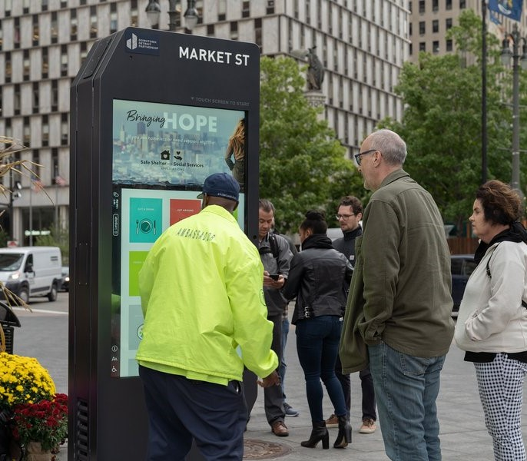
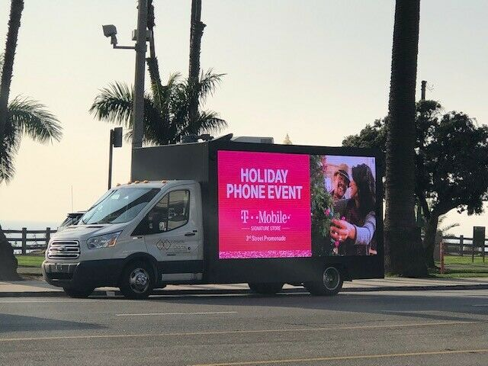
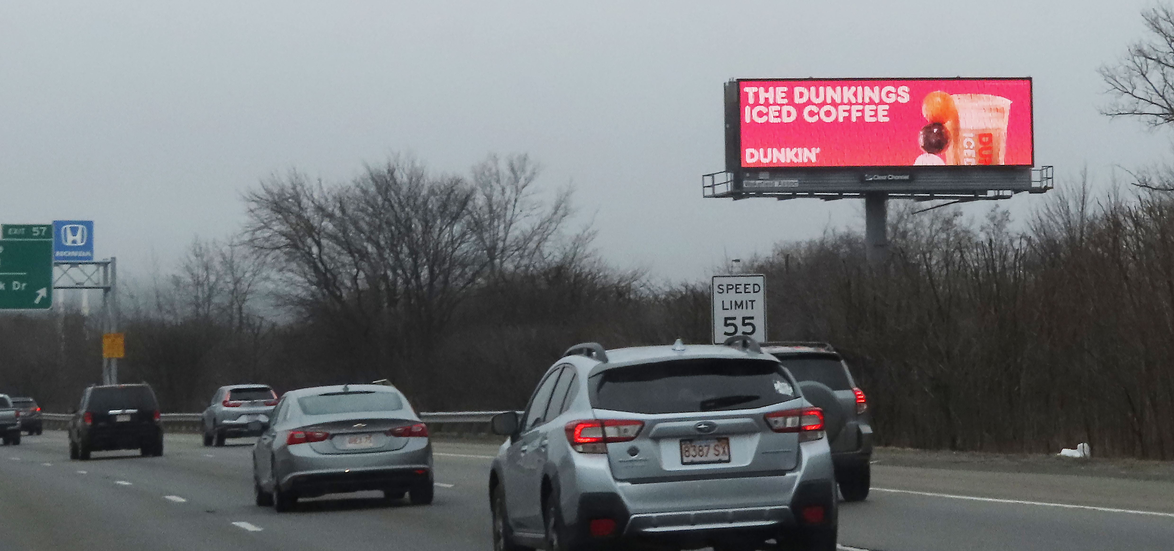
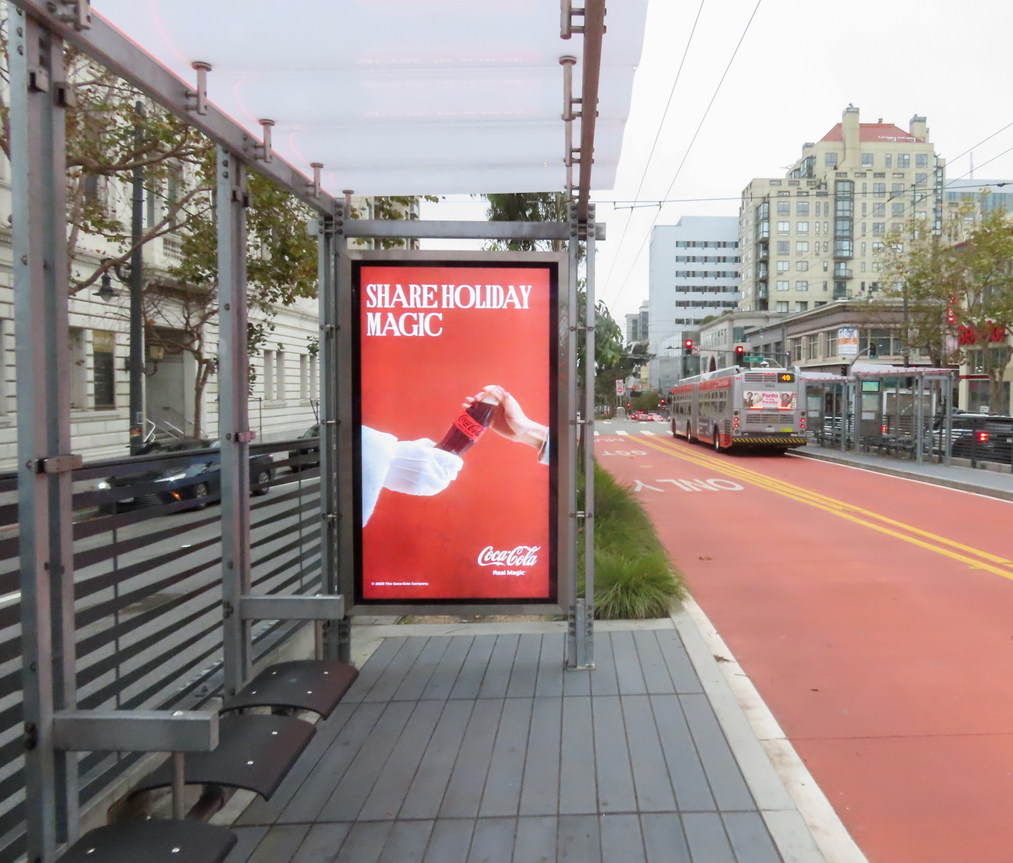
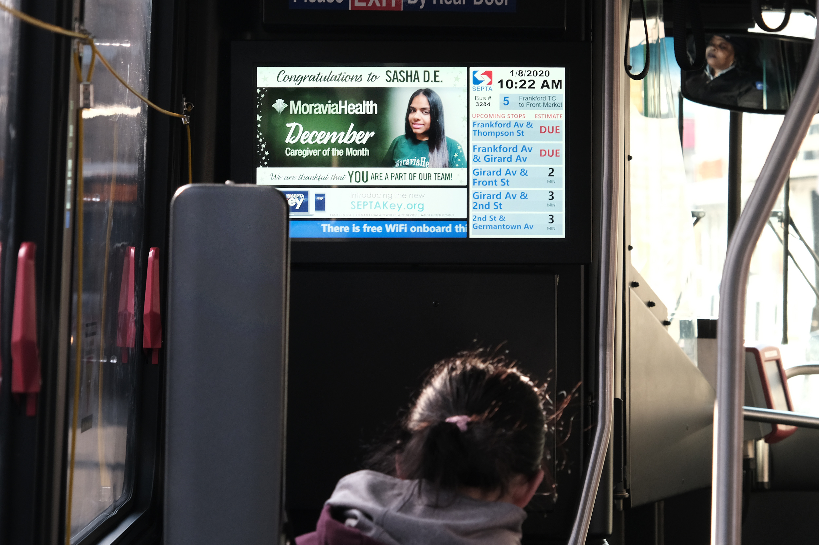
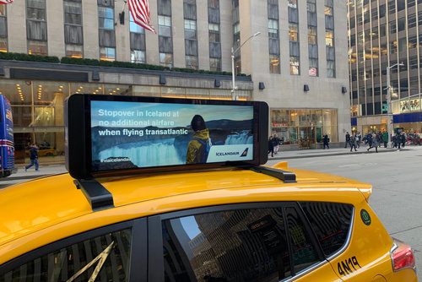
Images for Advertisement Types
Appendix
Digital billboards or posters
Street-level or sidewalk stationed
digital display advertising
Mobile billboards with digital displays
Digital screen ads on the side of or
inside a public bus
Digital screen ads on bus shelters
Digital screen ads on the inside or outside
of taxi cabs or ride share vehicles

Slide 41
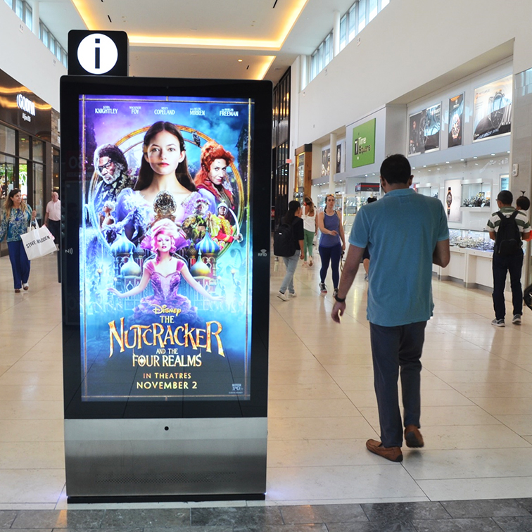
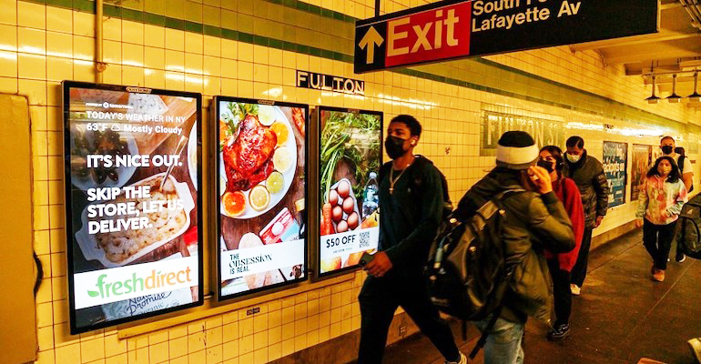
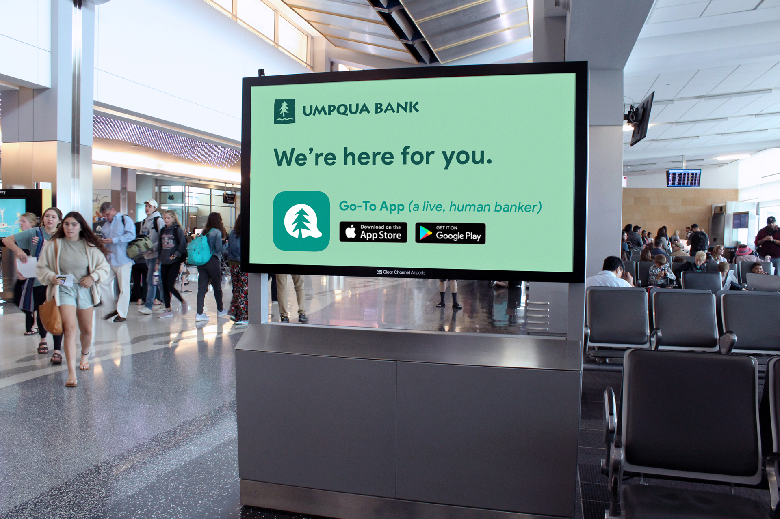
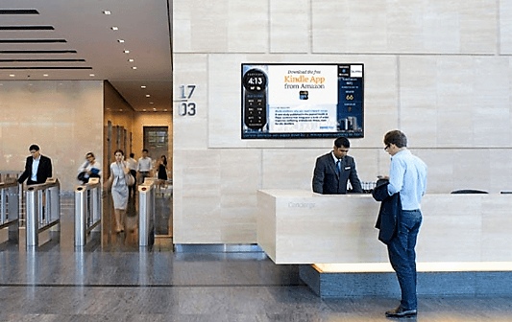
Images for Advertisement Types
Appendix
Digital screen ads in commuter rail or subway cars, platforms, or stations
Digital screen ads in airports
Digital screen ads in
shopping malls
Digital signage or video screens in
places of business
Ads on movie theater screens

Slide 42
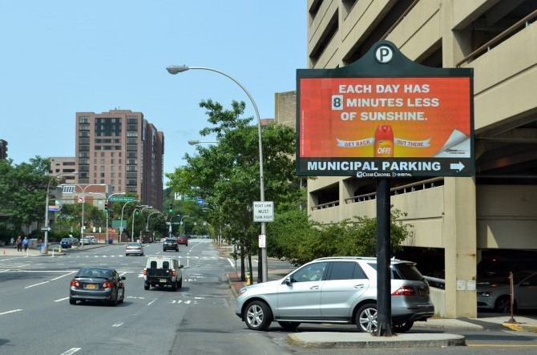
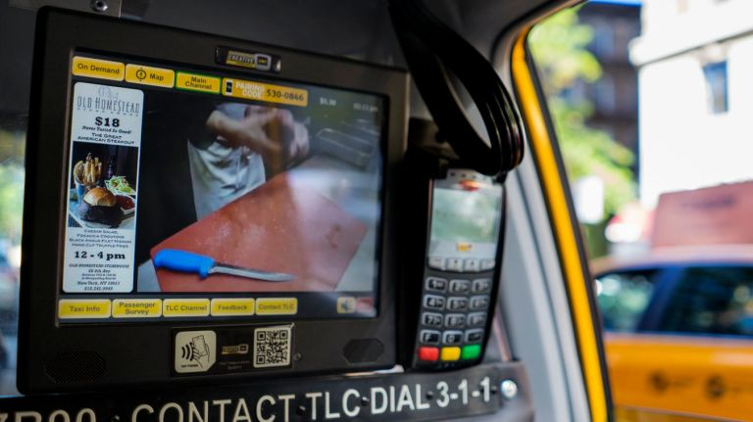
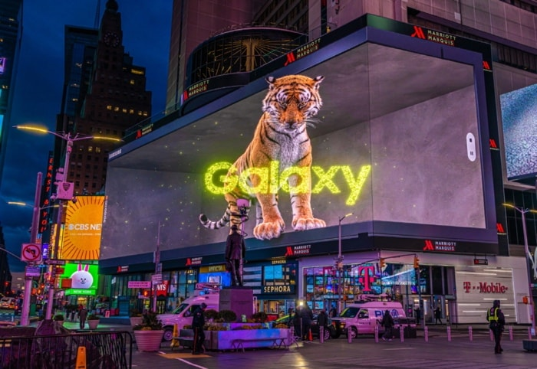
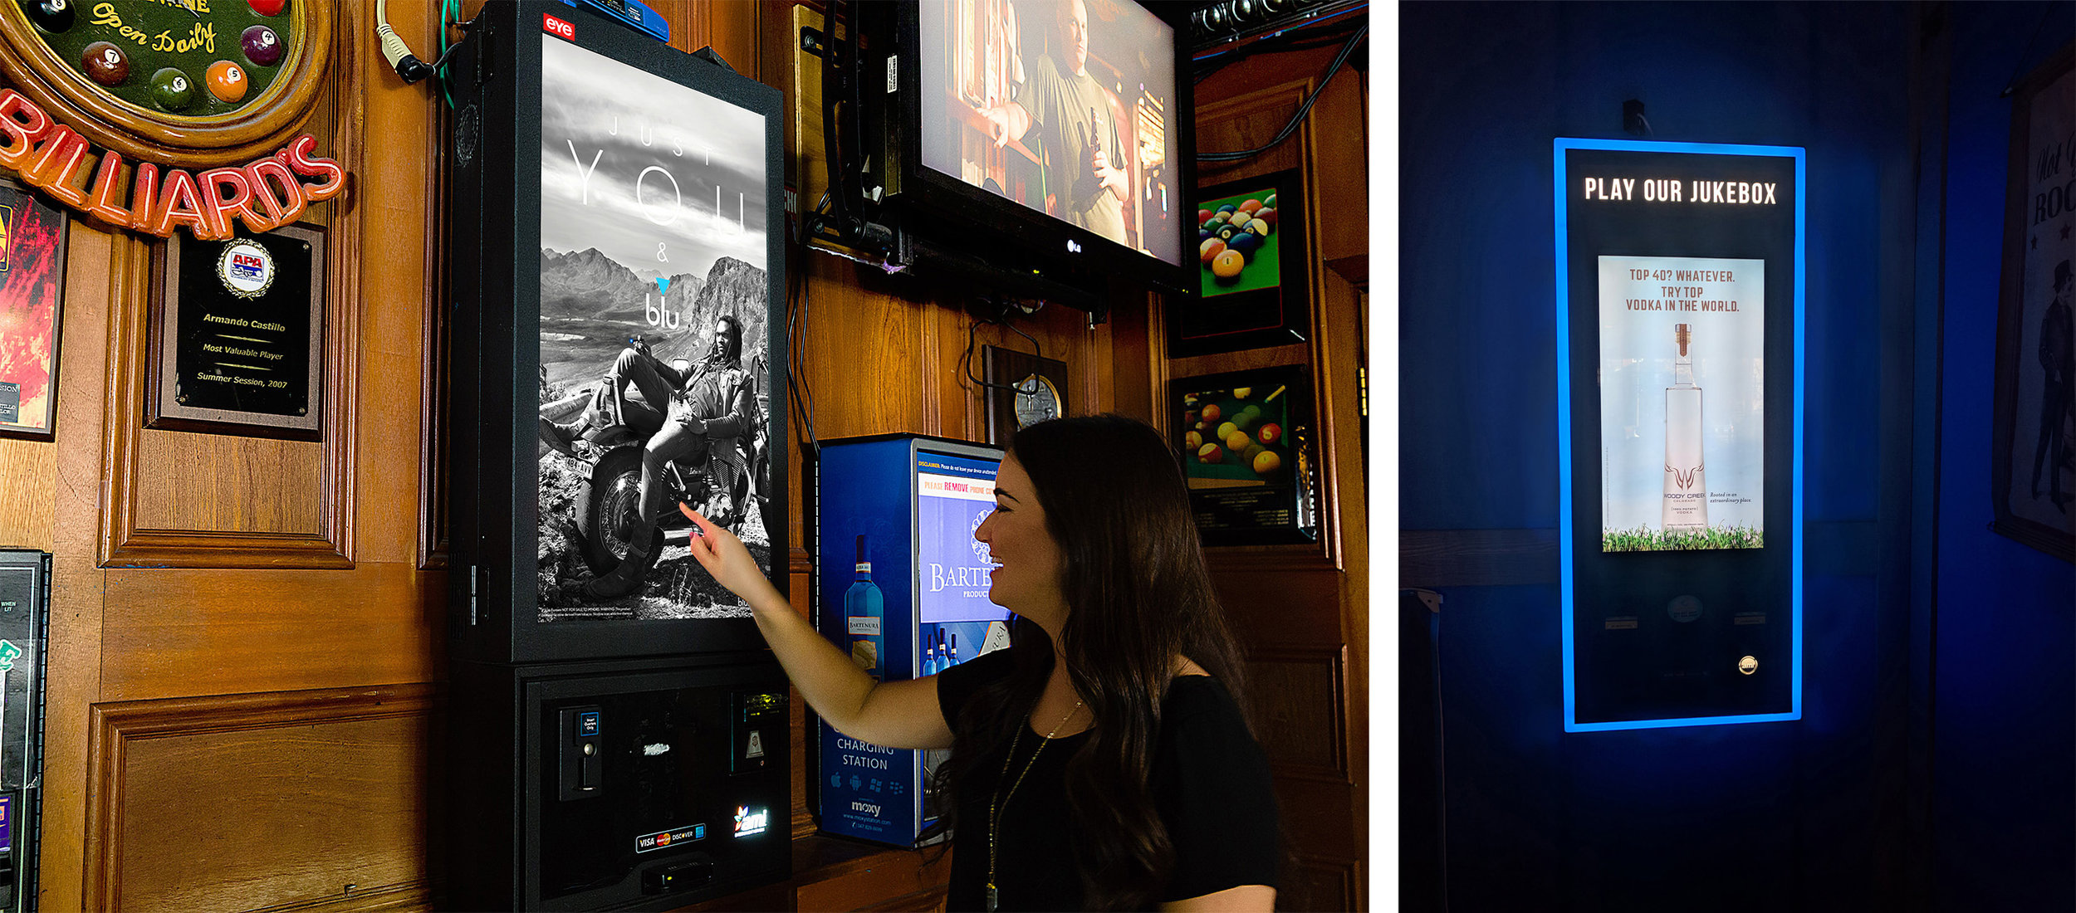
Images for Advertisement Types
Appendix
For Q335 and Q340
Digital billboards or posters
Digital transit
3D digital ads
Digital street level
Digital signage or video screens in places of business

Slide 43
“The Effectiveness of Digital OOH Advertising” study was sponsored by The Foundation for Out of Home Advertising Research and Education (FOARE), a 501 (c) (3) not for profit, charitable organization.

